Slide 1
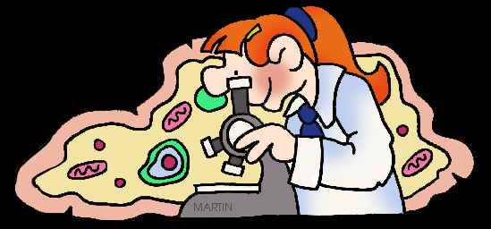
What is Science?

Slide 2
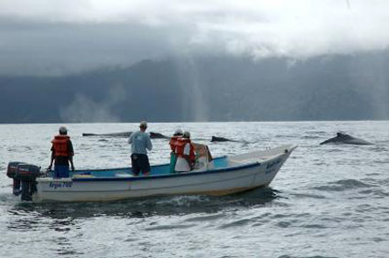
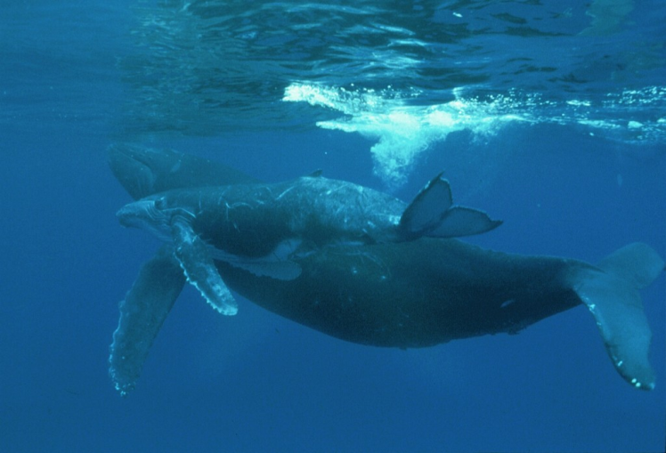
Science as a Way of Knowing
Science is an organized way of gathering and analyzing evidence about the natural world.
For example, researchers can use science to answer questions about how whales communicate, how far they travel, and how they are affected by environmental changes.

Slide 3
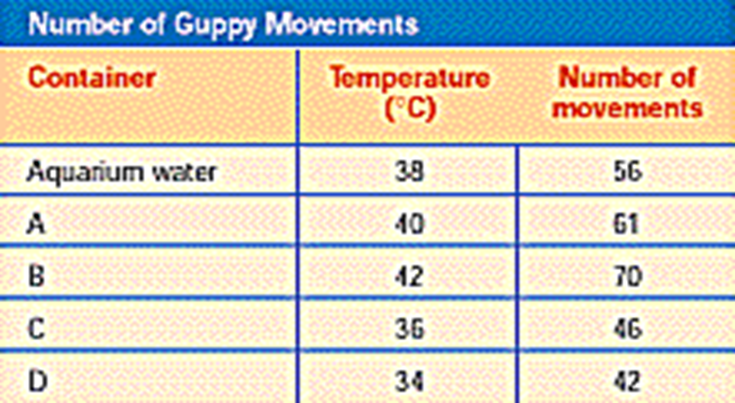
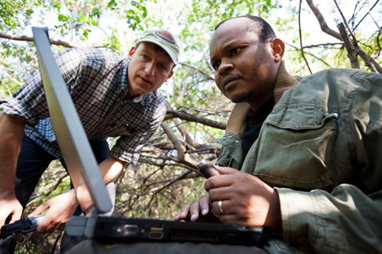
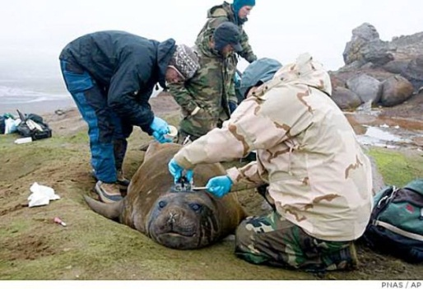
Science as a Way of Knowing
Science deals only with the natural world.
Scientists collect and organize information in an orderly way, looking for patterns and connections among events.
Scientists propose explanations that are based on evidence, not belief. Then they test those explanations with more evidence.

Slide 4
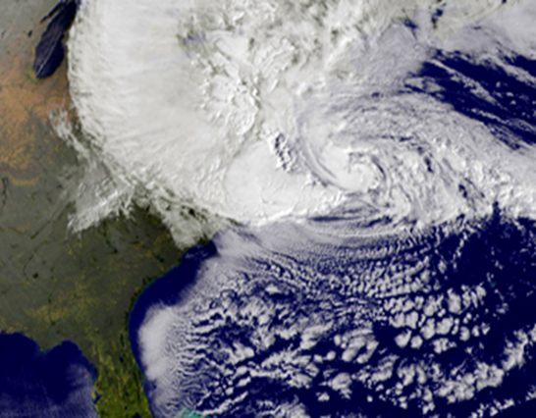
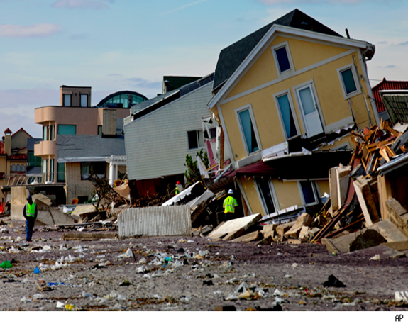
The Goals of Science
One goal of science is to provide natural explanations for events in the natural world.
Science also aims to use those explanations to understand patterns in nature and to make useful predictions about natural events.
Hurricane Sandy

Slide 5
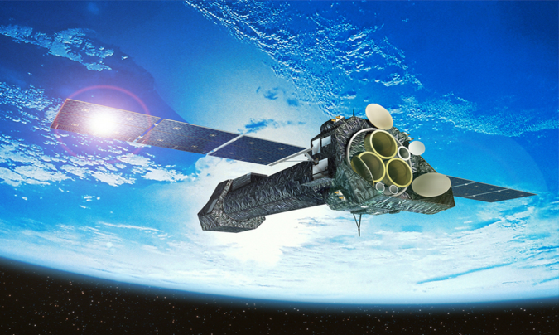
The Goals of Science
Science helps us…cure diseases
Science helps us…place satellites in orbit
Science helps us…send instantaneous electronic communications

Slide 6
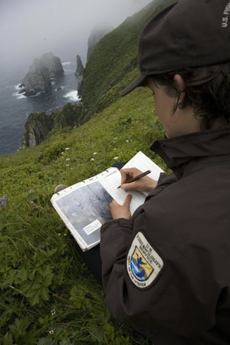
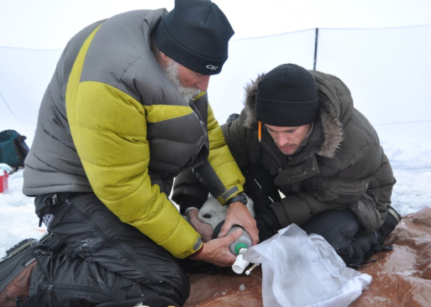
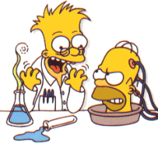
Scientific Method: The Heart of Science
Scientific method involves observing and asking questions, making inferences and forming hypotheses, conducting controlled experiments, collecting and analyzing data, and drawing conclusions.

Slide 7
Scientific Method: The Heart of Science
Suppose your family’s car won’t start. What do you do?
You might think that the procedures are a mystery. Not so! You use scientific thinking all the time…

Slide 8
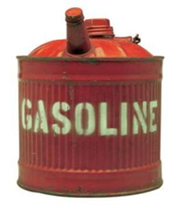
Scientific Method: The Heart of Science
Scientific method
1) involves observing and asking questions
2) making inferences and forming hypotheses
3) conducting controlled experiments
4) collecting and analyzing data
5) drawing conclusions.

Slide 9
Scientific Method Video
http://studyjams.scholastic.com/studyjams/jams/science/scientific-inquiry/scientific-methods.htm

Slide 10
Observing and Asking Questions
Scientific investigations begin with observation, the act of noticing and describing events or processes in a careful, orderly way.

Slide 11
Inferring and Forming a Hypothesis
After posing questions, scientists use further observations to make inferences, or logical interpretations based on what is already known.
Inference can lead to a hypothesis, or a scientific (logical) explanation for a set of observations that can be tested in ways that support or reject it.

Slide 12
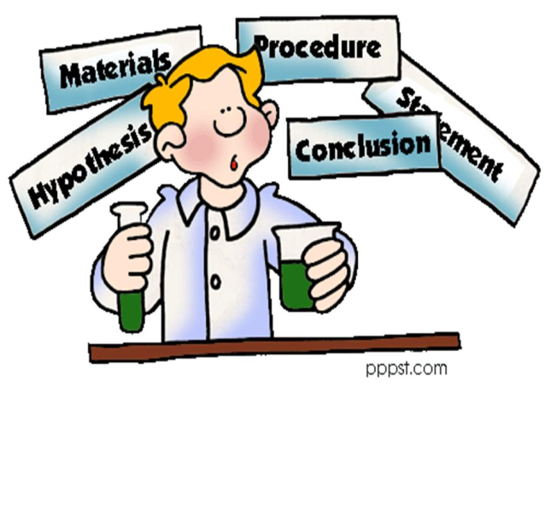
Inferring and Forming a Hypothesis
DO NOT SAY THAT AN HYPOTHESIS IS AN EDUCATED GUESS!!!!!

Slide 13
Inferring and Forming a Hypothesis
For example, researchers inferred that something limits grass growth in some places. Based on their knowledge of salt marshes, they hypothesized that marsh grass growth is limited by available nitrogen.

Slide 14
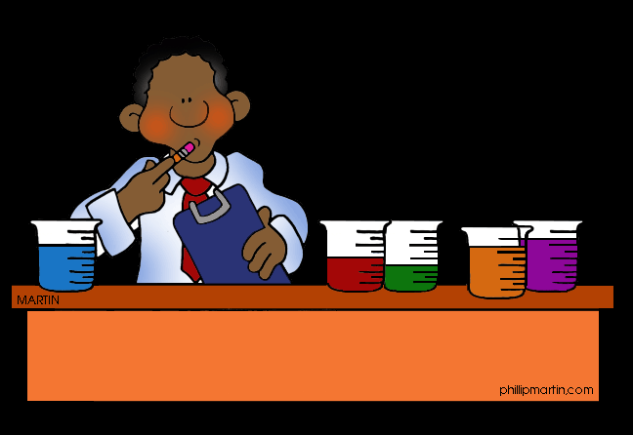
Designing Controlled Experiments
Testing a scientific hypothesis often involves designing an experiment that keeps track of various factors that can change, or variables. Examples of variables include temperature, light, time, and availability of nutrients.

Slide 15
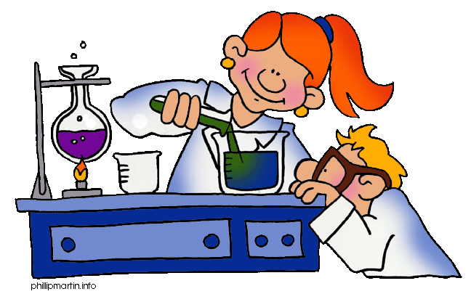
Designing Controlled Experiments
Whenever possible, a hypothesis should be tested by an experiment in which only one variable is changed. All other variables should be kept unchanged, or controlled. This type of experiment is called a controlled experiment.

Slide 16
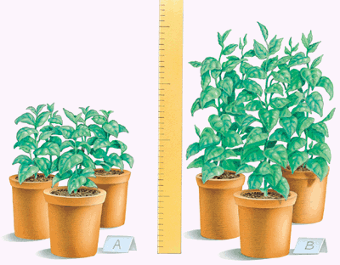
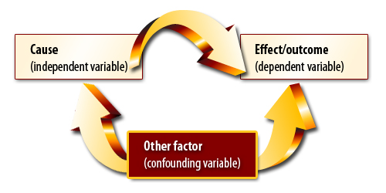
Controlling Variables
It is important to control variables because if several variables are changed in the experiment, researchers can’t easily tell which variable is responsible for any results they observe.

Slide 17
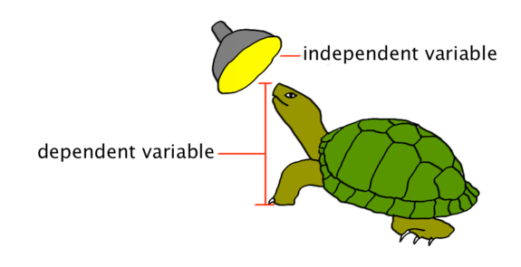
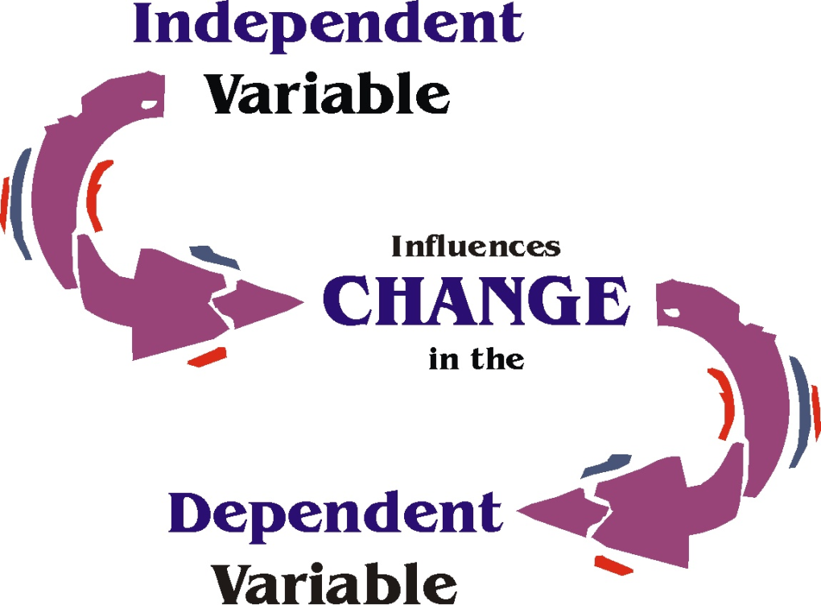
Controlling Variables
The variable that is deliberately changed is called the independent variable (also called the manipulated variable).
The variable that is observed and that changes in response to the independent variable is called the dependent variable (also called the responding variable).

Slide 18
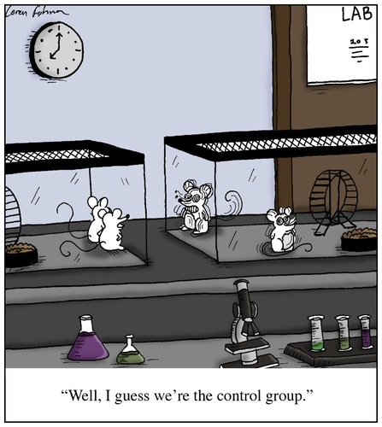
Control and Experimental Groups
Typically, an experiment is divided into control and experimental groups.
A control group is exposed to the same conditions as the experimental group except for one independent variable.
Scientists set up several sets of control and experimental groups to try to reproduce or replicate their observations.

Slide 19
Designing Controlled Experiments
For example, the researchers selected similar plots of marsh grass. All plots had similar plant density, soil type, input of freshwater, and height above average tide level. The plots were divided into control and experimental groups.

Slide 20
Designing Controlled Experiments
The researchers added nitrogen fertilizer (the independent variable) to the experimental plots. They then observed the growth of marsh grass (the dependent variable) in both experimental and control plots.

Slide 21
Collecting and Analyzing Data
Scientists record experimental observations, gathering information called data. There are two main types of data: quantitative data and qualitative data.

Slide 22
Collecting and Analyzing Data
Quantitative data are numbers obtained by counting or measuring. In the marsh grass experiment, it could include the number of plants per plot, plant sizes, and growth rates.

Slide 23
Collecting and Analyzing Data
Qualitative data are descriptive and involve characteristics that cannot usually be counted. In the marsh grass experiment, it might include notes about foreign objects in the plots, or whether the grass was growing upright or sideways.

Slide 24
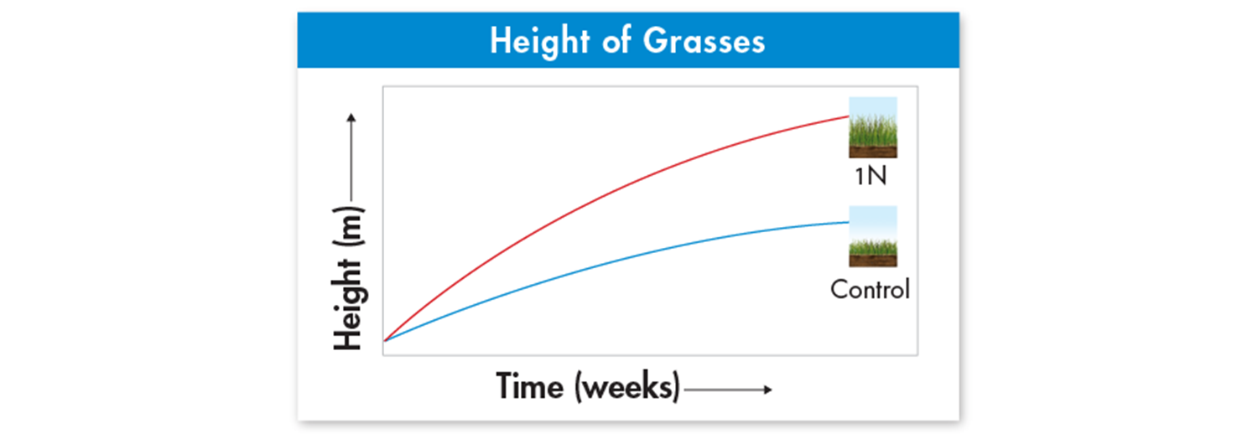
Research Tools
This graph shows how grass height changed over time.

Slide 25
Sources of Error
Researchers must be careful to avoid errors in data collection and analysis. Tools used to measure the size and weight of marsh grasses, for example, have limited accuracy.
Data analysis and sample size must be chosen carefully. The larger the sample size, the more reliably researchers can analyze variation and evaluate differences between experimental and control groups.

Slide 26
Drawing Conclusions
Scientists use experimental data as evidence to support, refute, or revise the hypothesis being tested, and to draw a valid conclusion.

Slide 27
Analysis showed that marsh grasses grew taller than controls by adding nitrogen.

Slide 28
When Experiments Are Not Possible
Sometimes, ethics prevents certain types of experiments—especially on human subjects.
For example, medical researchers who suspect that a chemical causes cancer, for example, would search for volunteers who have already been exposed to the chemical and compare them to people who have not been exposed to the chemical.
The researchers still try to control as many variables as possible, and might exclude volunteers who have serious health problems or known genetic conditions.
Medical researchers always try to study large groups of subjects so that individual genetic differences do not produce misleading results.

