Slide 1
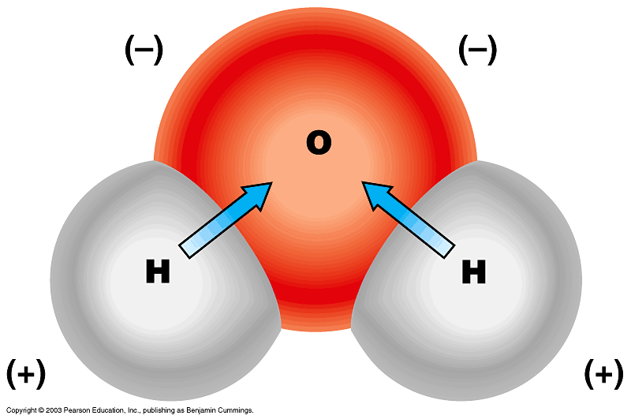
2.2 - Properties of Water
Most are a result of water’s ____________________________________ (unequal sharing of electrons)
Dipole

Slide 2
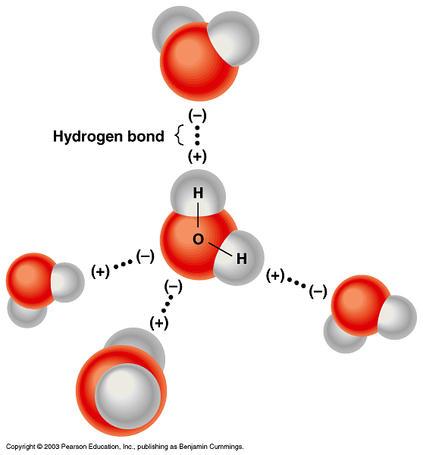
Covalent bonding vs. Hydrogen bonding
____________
___________

Slide 3
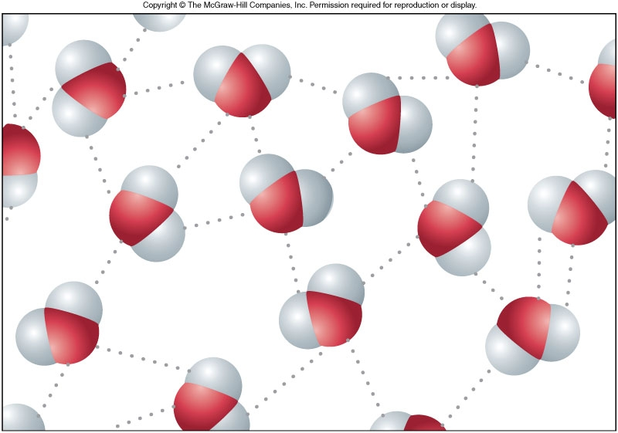

Slide 4
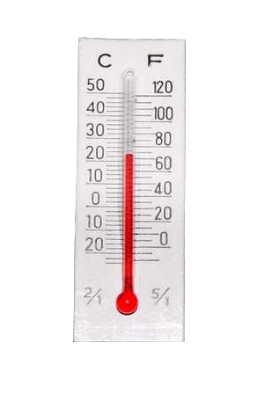
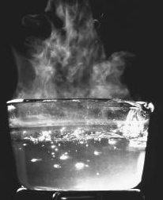
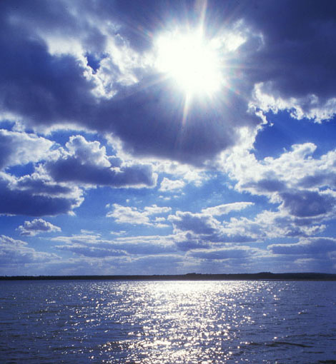
High Heat Capacity
____________= avg. kinetic energy of molecules
H-bonds hold molecules together and resist an increase in kinetic energy
Therefore, water has a ________________
_____________is the amount of energy required to heat one gram by one degree Celsius
Water’s specific heat = 1 calorie/gram °C
Alcohol’s specific heat = .6 calorie/gram °C
Aluminum’s specific heat = .06 calorie/gram °C

Slide 5
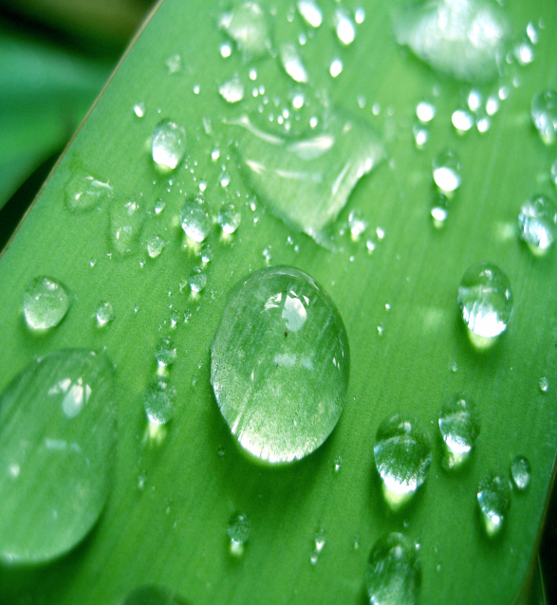
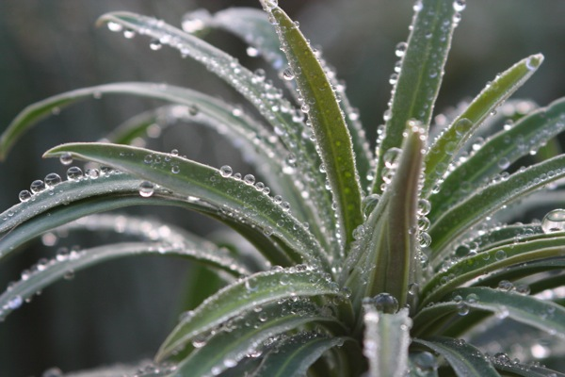
Cohesion, Adhesion and Surface Tension
_________________= water attracted to other water
__________________= water attracted to other materials
_____________________= ability of surface to resist an external force (“skin”)

Slide 6
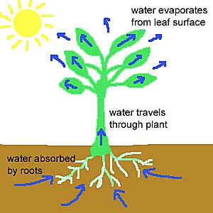
Capillary Action
Due to adhesion + cohesion
_______________- Water adheres to a material, then pulls other water via cohesion
Ex: Water moves through trees this way (_______________)

Slide 7
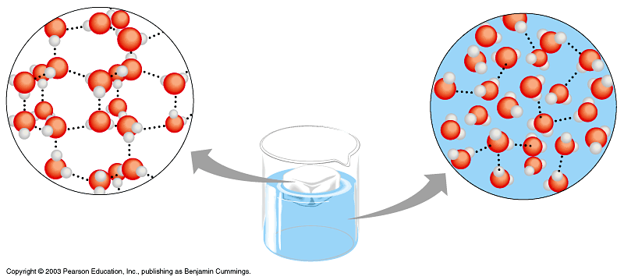
Less Dense as a Solid
Water is __________________ as a solid
_____________ – water molecules are bonded together (space between fixed)
______________– water molecules are constantly bonding and re-bonding (space is always changing)

Slide 8
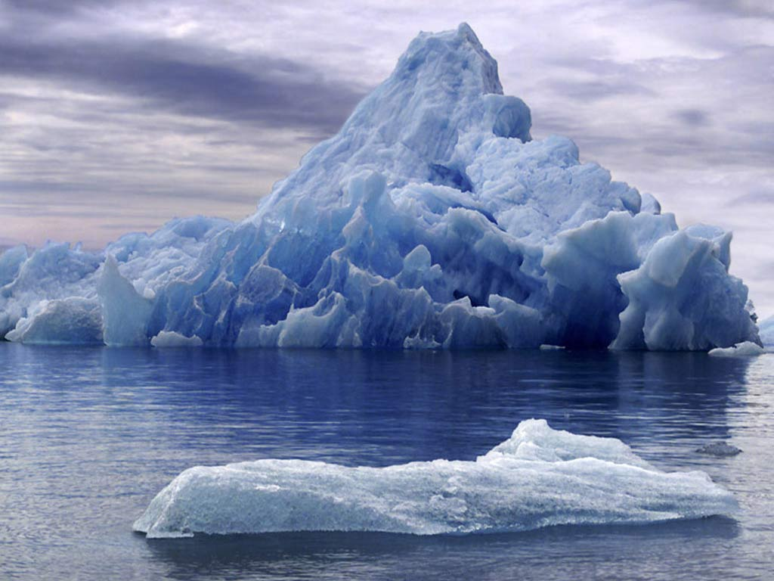
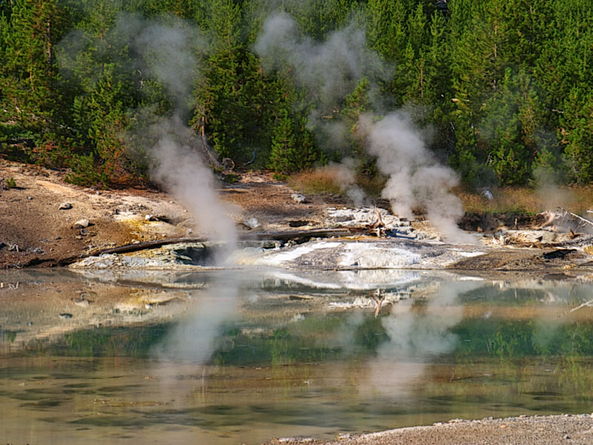
3 Phases of Matter
Water is the only substance that naturally occurs in a _______________________________________

Slide 9
Universal Solvent
Water is the most versatile solvent on Earth!
_____________ – substance dissolved in a solvent to form a solution
_____________– fluid that dissolves solutes
Example: Iced Tea – water is the solvent, tea & sugar are the solutes

