Slide 1
Chapter 13-3: Mutations
13-3
Evaluate the severity of various genetic mutations
Objectives:
Explain the difference between gene mutations and chromosomal mutations

Slide 2
Mutations
Gene Mutations
Chromosomal Mutations
Point Mutations
Substitutions
Frameshift Mutations
Insertions
Deletions
Deletion
Duplication
Inversion
Translocation

Slide 3
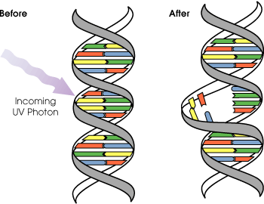
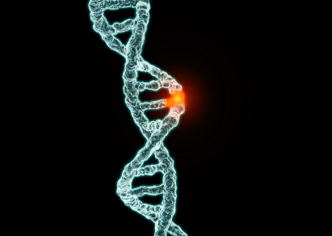
Gene Mutations
13-3
Small DNA changes
One or a few nucleotides
Point mutations occur at a single point in the DNA sequence
3 Types of point mutations:
Substitutions
Deletions
Insertions

Slide 4
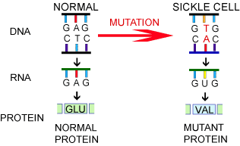
Substitution Mutations
13-3
One nitrogenous base is changed to another
Usually affects only one amino acid
Least harmful mutation
Substitution

Slide 5
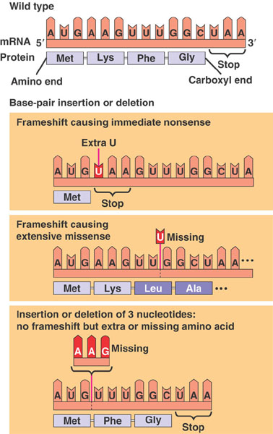
Frameshift Mutations
13-3
Caused by either a deletion or an insertion
Entire “reading frame” is shifted
Multiple amino acids affected
Deletion

Slide 6
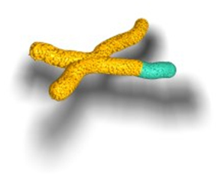
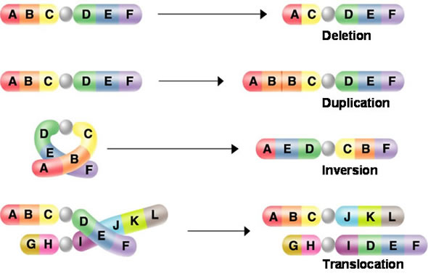
Chromosomal Mutations
13-3
Changes in the number or structure of entire chromosomes
Impacts much more genetic information than gene mutations
Much more severe
4 Types:
Deletion
Duplication
Inversion
Translocation
Original

Slide 7
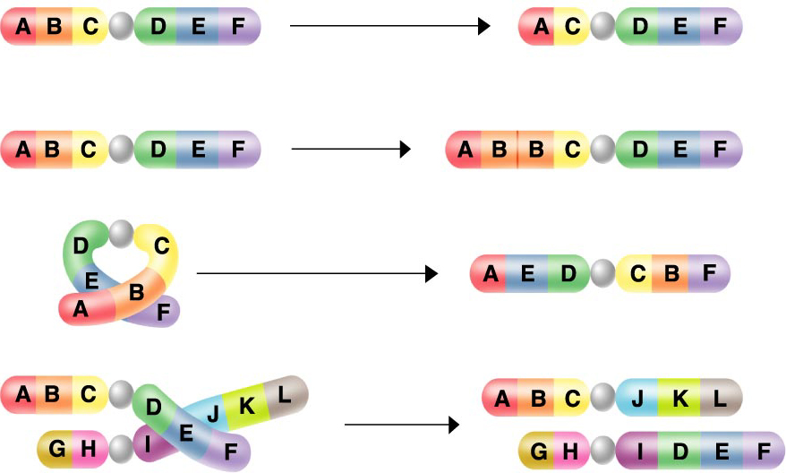
Chromosomal Mutations
13-3
Deletion
Duplication
Inversion
Translocation

Slide 8
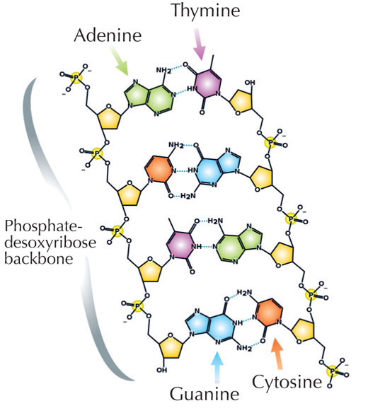
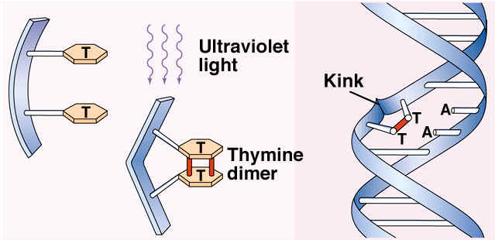
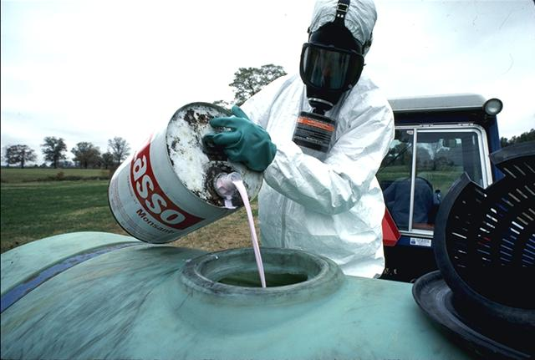
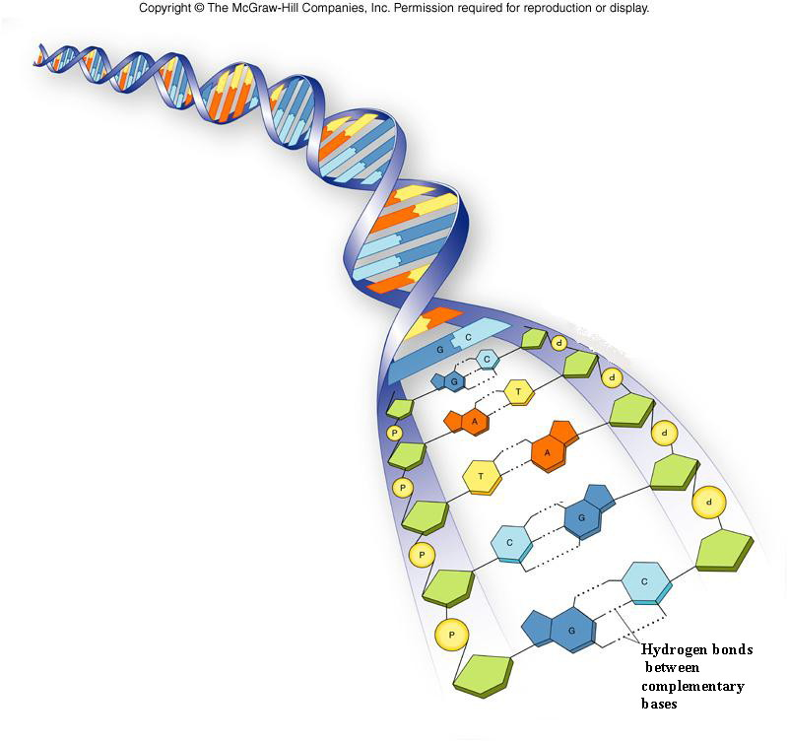
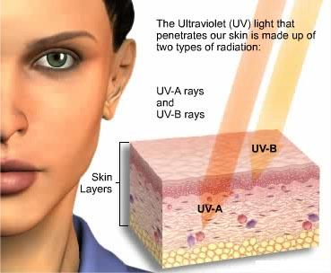
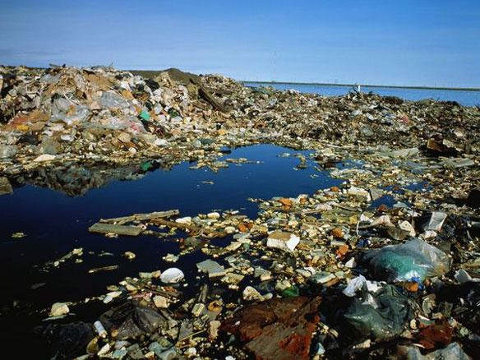
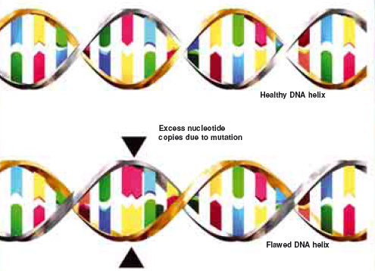
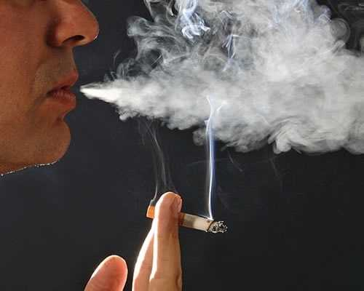
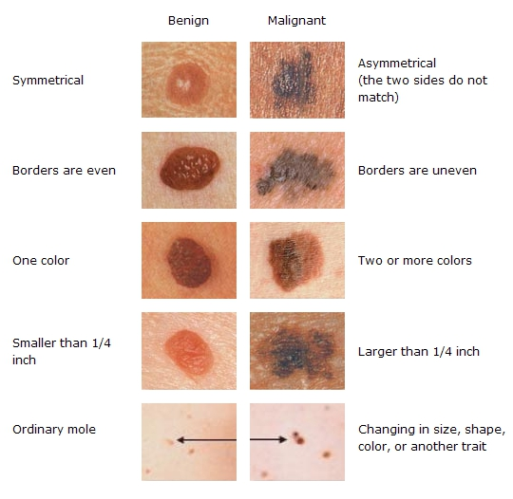
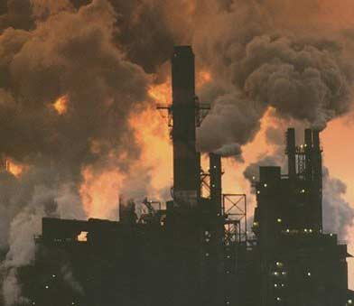
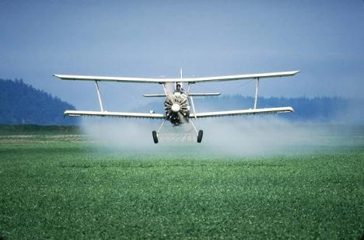
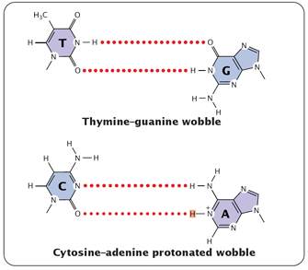
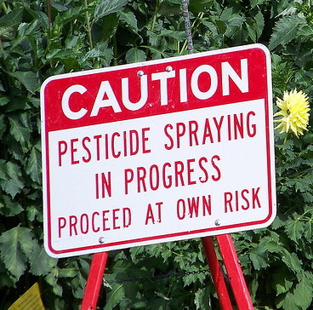
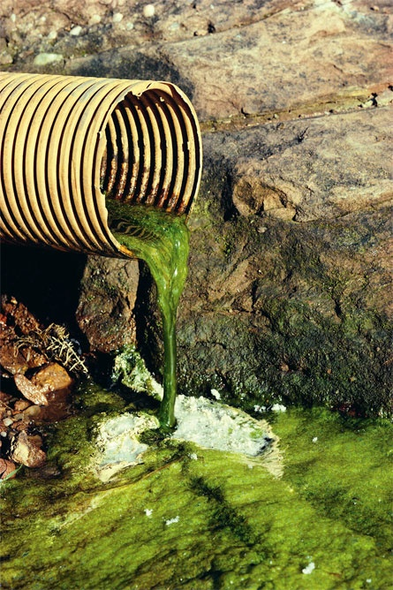
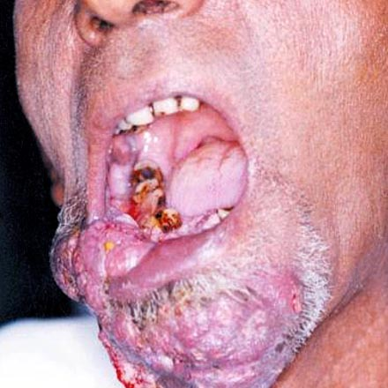
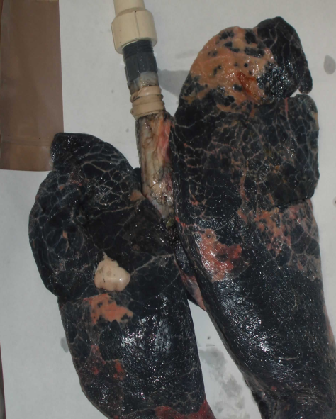
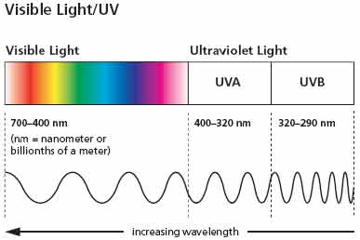
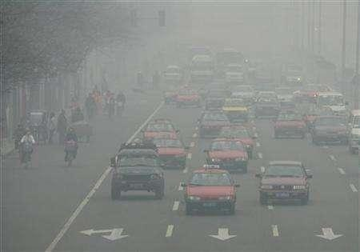
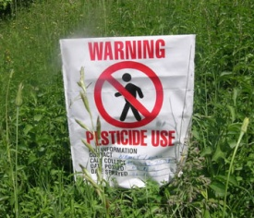
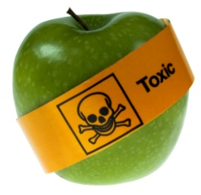
Causes of Mutations
13-3
Natural:
Errors in DNA replication, transcription, or translation
Reproduction rate
Age
Artificial:
Mutagens- physical or chemical agents that cause mutations
Pesticides
Radiation (e.g. UV light)
Pollution
Tobacco smoke

Slide 9
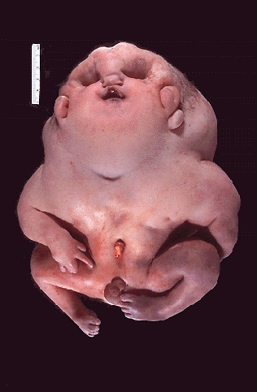
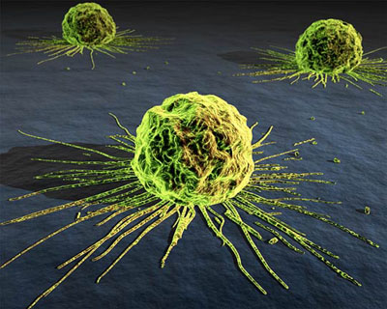
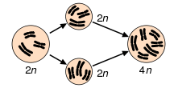
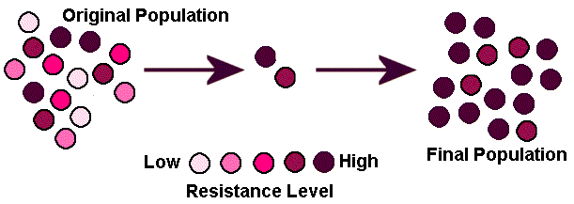
Effects of Mutations
13-3
Most mutations are harmful
Cancer
Disorders
Deformities
Some are beneficial:
Polyploidly- organisms with extra sets of chromosomes
Resistance to chemicals and diseases
Evolution

Slide 10
Mutations
http://www.youtube.com/watch?v=gqvYOr78THo&feature=related

Slide 11
Mutations
Gene Mutations
Chromosomal Mutations
Point Mutations
Substitutions
Frameshift Mutations
Insertions
Deletions
Deletion
Duplication
Inversion
Tanslocation

Slide 12
Chapter 13-4: Gene Regulation
13-4
Objectives:
Explain how genes are turned on and off
Compare/contrast prokaryotic and eukaryotic gene regulation

Slide 13
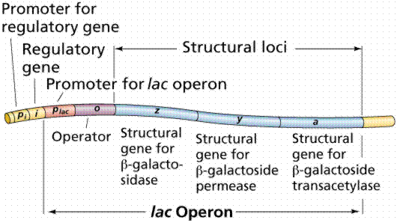
Gene Expression
13-4
Only a fraction of genes are expressed at any time
Genes contain regulatory sites called operators to turn genes on and off
Operators often control multiple genes called an operon

Slide 14
Lac Operon
13-4
E. Coli and other prokaryotes use lactose for food
When lactose is absent a repressor binds to the operator and stops RNA polymerase from transcribing the gene
The enzymes to break down lactose aren’t needed and are therefore not produced

Slide 15
Lac Operon
13-4
When lactose is present the operon is turned on
Lactose acts as an inducer which binds to the repressor and removes it from the operator
Transcription may then occur
The enzymes necessary for lactose digestion are translated

Slide 16
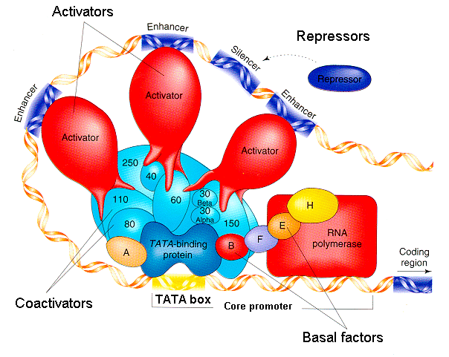
Eukaryotic Gene Regulation
13-4
No operons
More complex
Each gene is independently regulated
Enhancers uncoil DNA and attract the transcription complex
Transcription factors (proteins) and RNA polymerase
Transcription complex binds at the TATA box
~30 base pair sequence beginning with TATATA or TATAAA
Part of promoter sequence
Transcription begins at the end of the TATA box
Requires ATP

Slide 17
Eukaryotic Gene Regulation
13-4

