Slide 1
7.3 Cell Transport

Slide 2
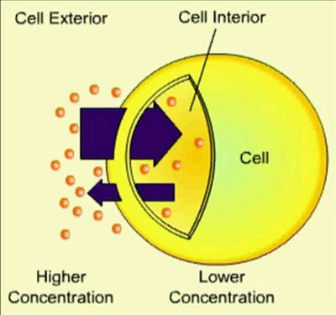
Diffusion
The cytoplasm of a cell is a solution of many different substances dissolved in water.
In any solution, solute particles tend to move from an area where they are more concentrated to an area where they are less concentrated.
The process by which particles move from an area of high concentration to an area of lower concentration is known as diffusion.

Slide 3
Diffusion
Suppose a substance is present in unequal concentrations on either side of a cell membrane.

Slide 4
Diffusion
If the substance can cross the cell membrane, its particles will tend to move toward the area where it is less concentrated until it is evenly distributed.

Slide 5
Diffusion
At that point, the concentration of the substance on both sides of the
cell membrane is the same, and equilibrium is reached.

Slide 6
Diffusion
Even when equilibrium is reached, particles of a solution will continue to move across the membrane in both directions.
Because almost equal numbers of particles move in each direction, there is no net change in the concentration on either side.

Slide 7
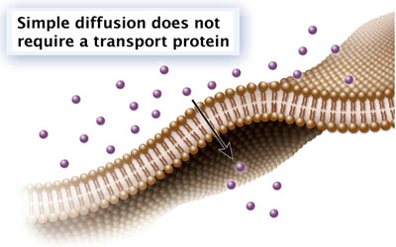
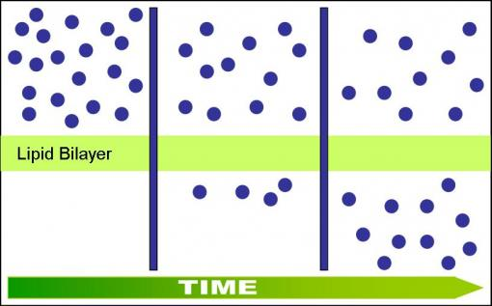
Diffusion
Diffusion depends upon random particle movements. Substances diffuse across membranes without requiring the cell to use additional energy.
The movement of materials across the cell membrane without using cellular energy is called passive transport.

Slide 8
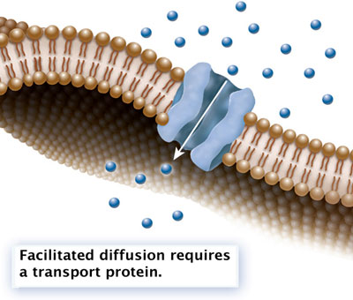
Facilitated Diffusion
Cell membranes have proteins that act as carriers, or channels, making it easy for certain molecules to cross.
Molecules that cannot directly diffuse across the membrane pass through special protein channels in a process known as facilitated diffusion.

Slide 9
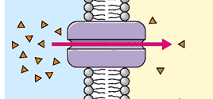
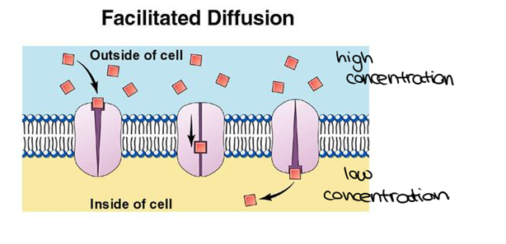
Facilitated Diffusion
Hundreds of different proteins have been found that allow particular substances to cross cell membranes.
The movement of molecules by facilitated diffusion does not require any additional use of the cell’s energy.

Slide 10
Osmosis: An Example of Facilitated Diffusion
The inside of a cell’s lipid bilayer is hydrophobic—or “water-hating.” Because of this, water molecules have a tough time passing through the cell membrane.
Many cells contain water channel proteins, known as aquaporins, that allow water to pass right through them. Without aquaporins, water would diffuse in and out of cells very slowly.
The movement of water through cell membranes by facilitated diffusion is an extremely important biological process—the process of osmosis.

Slide 11
Osmosis: An Example of Facilitated Diffusion
Osmosis is the diffusion of water through a selectively permeable membrane.
Osmosis involves the movement of water molecules from an area of higher concentration to an area of lower concentration.

Slide 12
How Osmosis Works
In the experimental setup below, the barrier is permeable to water but not to sugar. This means that water molecules can pass through the barrier, but the solute, sugar, cannot.

Slide 13
How Osmosis Works
There are more sugar molecules on the right side of the barrier than on the left side. Therefore, the concentration of water is lower on the right, where more of the solution is made of sugar.

Slide 14
How Osmosis Works
There is a net movement of water into the compartment containing the concentrated sugar solution.
Water will tend to move across the barrier until equilibrium is reached. At that point, the concentrations of water and sugar will be the same on both sides.

Slide 15
How Osmosis Works
When the concentration is the same on both sides of the membrane, the two solutions will be isotonic, which means “same strength.”

Slide 16
How Osmosis Works
The more concentrated sugar solution at the start of the experiment was hypertonic, or “above strength,” compared to the dilute sugar solution.
The dilute sugar solution was hypotonic, or “below strength.”

Slide 17
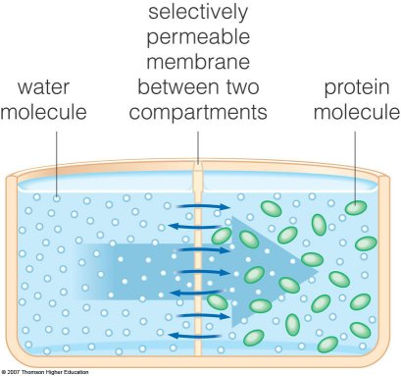
Osmotic Pressure
For organisms to survive, they must have a way to balance the intake and loss of water.
The net movement of water out of or into a cell exerts a force known as osmotic pressure.

Slide 18
Osmotic Pressure
Because the cell is filled with salts, sugars, proteins, and other molecules, it is almost always hypertonic to fresh water.
As a result, water tends to move quickly into a cell surrounded by fresh water, causing it to swell. Eventually, the cell may burst.

Slide 19
Osmotic Pressure
In plants, the movement of water into the cell causes the central vacuole to swell, pushing cell contents out against the cell wall.
Since most cells in large organisms do not come in contact with fresh water, they are not in danger of bursting.

Slide 20
Osmotic Pressure
Instead, the cells are bathed in fluids, such as blood, that are isotonic and have concentrations of dissolved materials roughly equal to those in the cells.
Cells placed in an isotonic solution neither gain nor lose water.

Slide 21
Osmotic Pressure
In a hypertonic solution, water rushes out of the cell, causing animal cells to shrink and plant cell vacuoles to collapse.

Slide 22
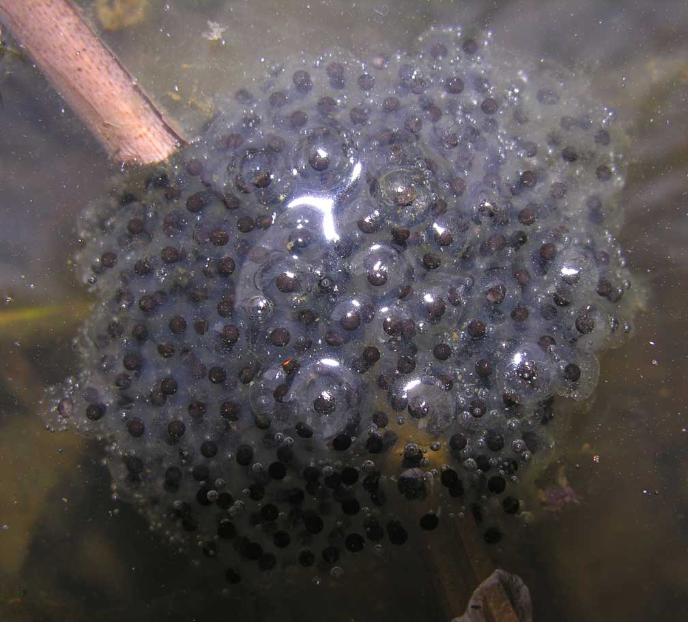
Osmotic Pressure
Some cells, such as the eggs laid by fish and frogs, must come into contact with fresh water. These types of cells tend to lack water channels.
As a result, water moves into them so slowly that osmotic pressure does not become a problem.

Slide 23
Osmotic Pressure
Other cells, including those of plants and bacteria, that come into contact with fresh water are surrounded by tough cell walls that prevent the cells from expanding, even under tremendous osmotic pressure.

Slide 24
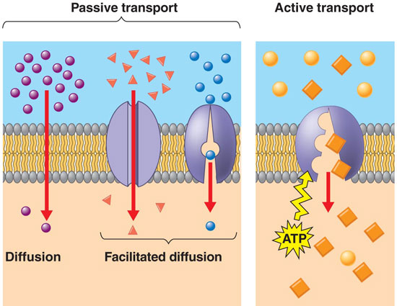
Active Transport
Cells sometimes must move materials against a concentration difference.
The movement of material against a concentration difference is known as active transport. Active transport requires energy.

Slide 25
Active Transport
The active transport of small molecules or ions across a cell membrane is generally carried out by transport proteins, or protein “pumps,” that are found in the membrane itself.

Slide 26
Active Transport
Larger molecules and clumps of material can also be actively transported across the cell membrane by processes known as endocytosis and exocytosis.
The transport of these larger materials sometimes involves changes in the shape of the cell membrane.

Slide 27
Endocytosis
Endocytosis is the process of taking material into the cell by means of infoldings, or pockets, of the cell membrane.
The pocket that results breaks loose from the outer portion of the cell membrane and forms a vesicle or vacuole within the cytoplasm.

Slide 28
Endocytosis
Large molecules, clumps of food, and even whole cells can be taken up by endocytosis.
Two examples of endocytosis are phagocytosis and pinocytosis.

Slide 29
Endocytosis
In pinocytosis, cells take up liquid from the surrounding environment by forming tiny pockets along the cell membrane.
The pockets fill with liquid and pinch off to form vacuoles within the cell.

Slide 30
Exocytosis
Many cells also release large amounts of material from the cell, a process known as exocytosis.
During exocytosis, the membrane of the vacuole surrounding the material fuses with the cell membrane, forcing the contents out of the cell.

