Slide 1
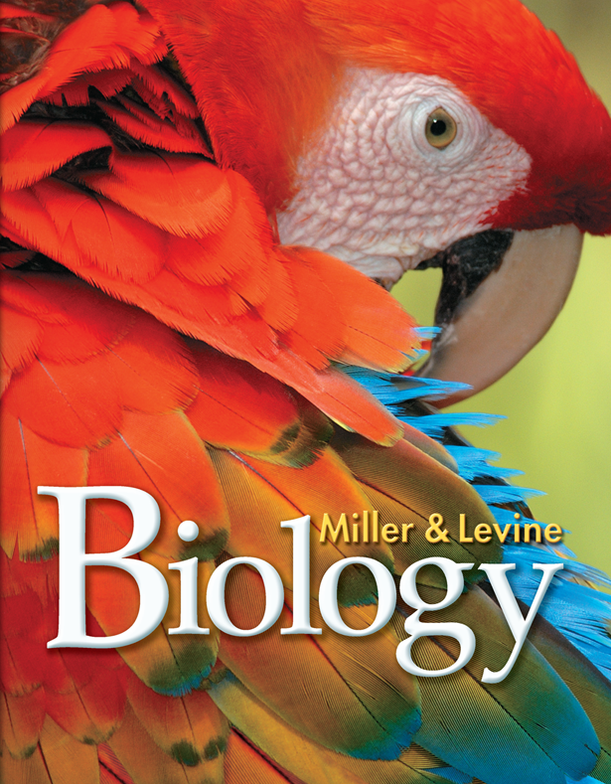
Lesson Overview
19.3 Earth’s Early History

Slide 2
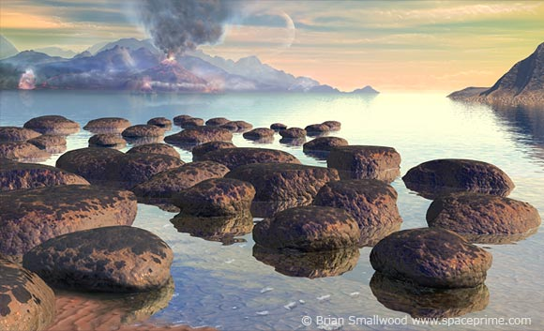
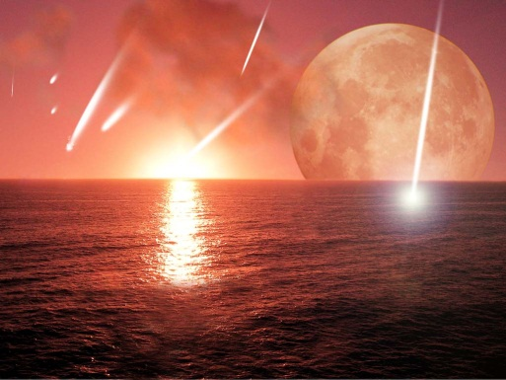
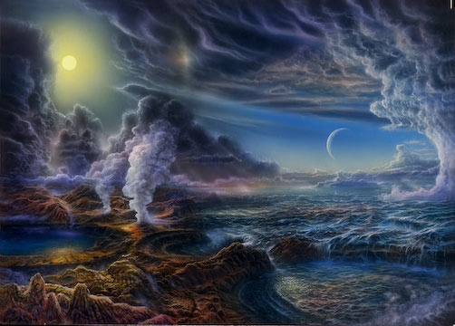
The Mysteries of Life’s Origins
Geological and astronomical evidence suggests that Earth formed as pieces of cosmic debris collided with one another. While the planet was young, it was struck by one or more huge objects, and the entire globe melted.
For millions of years, violent volcanic activity shook Earth’s crust. Comets and asteroids bombarded its surface.
About 4.2 billion years ago, Earth cooled enough to allow solid rocks to form and water to condense and fall as rain. Earth’s surface became stable enough for permanent oceans to form.

Slide 3
The Mysteries of Life’s Origins
This infant planet was very different from Earth today.
Earth’s early atmosphere contained little or no oxygen. It was principally composed of carbon dioxide, water vapor, and nitrogen, with lesser amounts of carbon monoxide, hydrogen sulfide, and hydrogen cyanide.
Because of the gases in the atmosphere, the sky was probably pinkish-orange.
Because they contained lots of dissolved iron, the oceans were probably brown.

Slide 4
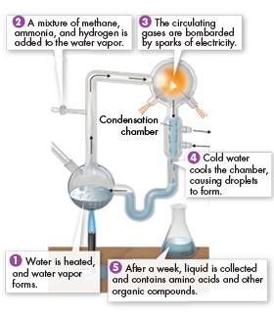
The First Organic Molecules
In 1953, chemists Stanley Miller and Harold Urey tried recreating conditions on early Earth to see if organic molecules could be assembled under these conditions.
1) They filled a sterile flask with water, to simulate the oceans, and boiled it.

Slide 5
The First Organic Molecules
2) To the water vapor, they added methane, ammonia, and hydrogen, to simulate what they thought had been the composition of Earth’s early atmosphere.
3) They passed the gases through electrodes, to simulate lightning.

Slide 6
The First Organic Molecules
4) Next, they passed the gases through a condensation chamber, where cold water cooled them, causing drops to form. The liquid continued to circulate through the experimental apparatus for a week.
5) After a week, they had produced 21 amino acids—building blocks of proteins.

Slide 7
The First Organic Molecules
Miller and Urey’s experiment suggested how mixtures of the organic compounds necessary for life could have arisen from simpler compounds on a primitive Earth.
We now know that Miller and Urey’s ideas on the composition of the early atmosphere were incorrect. But new experiments based on current ideas of the early atmosphere have produced similar results.

Slide 8
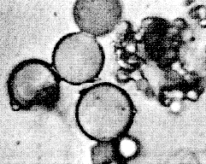
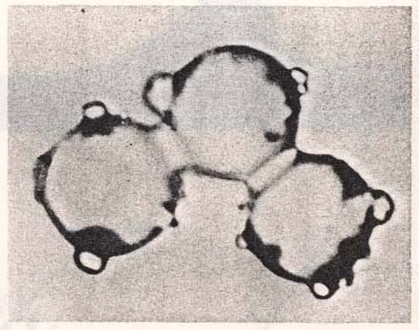
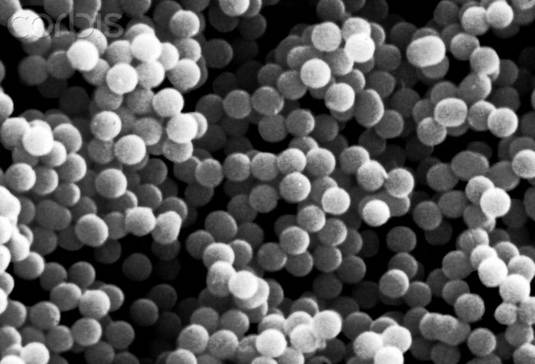
Formation of Microspheres
Geological evidence suggests that during the Archean Eon, 200 to 300 million years after Earth cooled enough to carry liquid water, cells similar to bacteria were common. How did these cells originate?
Large organic molecules form tiny bubbles called proteinoid microspheres under certain conditions.
Microspheres are not cells, but they have some characteristics of living systems.

Slide 9
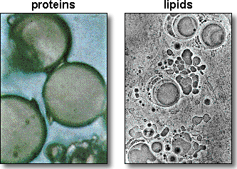
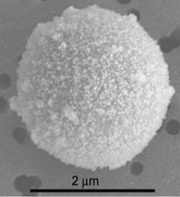
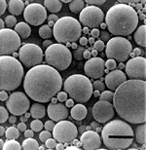
Formation of Microspheres
Like cells, microspheres have selectively permeable membranes through which water molecules can pass.
Microspheres also have a simple means of storing and releasing energy.
Several hypotheses suggest that structures similar to proteinoid microspheres acquired the characteristics of living cells as early as 3.8 billion years ago.

Slide 10
Evolution of RNA and DNA
Cells are controlled by information stored in DNA, which is transcribed into RNA and then translated into proteins.
The “RNA world” hypothesis about the origin of life suggests that RNA evolved before DNA. From this simple RNA-based system, several steps could have led to DNA-directed protein synthesis.

Slide 11
Evolution of RNA and DNA
One hypothesis about the origin of life suggests that RNA evolved before DNA.

Slide 12
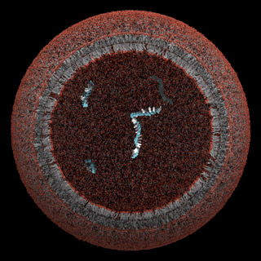
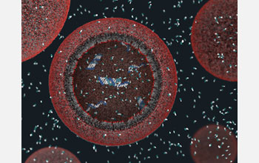
Production of Free Oxygen
Microscopic fossils, or microfossils, of prokaryotes that resemble bacteria have been found in rocks more than 3.5 billion years old.
Those first life forms evolved in the absence of oxygen because at that time, Earth’s atmosphere contained very little of that highly reactive gas.

Slide 13
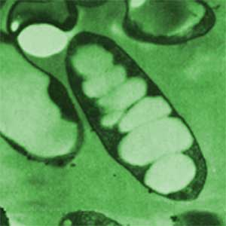
Production of Free Oxygen
Photosynthetic bacteria became common. By 2.2 billion years ago, these organisms were producing oxygen.

Slide 14
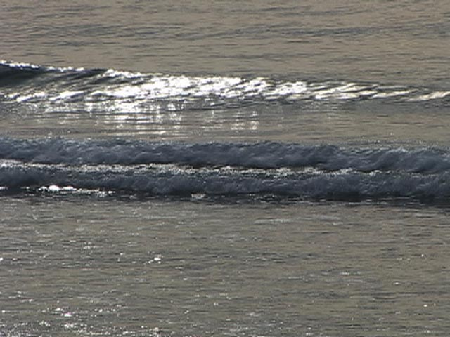
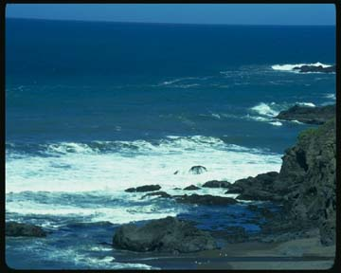
Production of Free Oxygen
At first, the oxygen combined with iron in the oceans, producing iron oxide, or rust.
Iron oxide, which is not soluble in water, sank to the ocean floor and formed great bands of iron that are the source of most iron ore mined today.
Without iron, the oceans changed color from brown to blue-green.

Slide 15
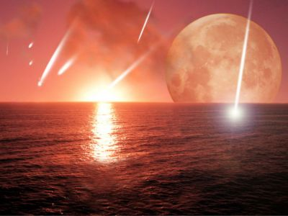
Production of Free Oxygen
Next, oxygen gas began to accumulate in the atmosphere. The ozone layer began to form, and the skies turned their present shade of blue.
Over several hundred million years, oxygen concentrations rose until they reached today’s levels

Slide 16
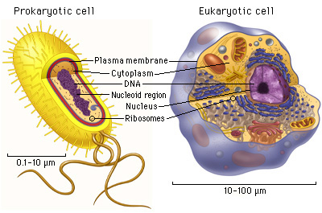
Origin of Eukaryotic Cells
One of the most important events in the history of life was the evolution of eukaryotic cells from prokaryotic cells.
Eukaryotic cells have nuclei, but prokaryotic cells do not.
Eukaryotic cells also have complex organelles. Virtually all eukaryotes have mitochondria, and both plants and algae also have chloroplasts.

Slide 17
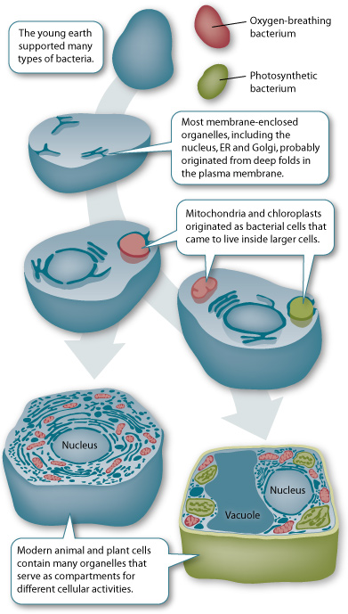
Endosymbiotic Theory
It is believed that about 2 billion years ago, some ancient prokaryotes began evolving internal cell membranes. These prokaryotes were the ancestors of eukaryotic organisms.
According to endosymbiotic theory, prokaryotic cells entered those ancestral eukaryotes. The small prokaryotes began living inside the larger cells.

Slide 18
Endosymbiotic Theory
Over time a symbiotic relationship evolved between primitive eukaryotic cells and prokaryotic cells in them.

Slide 19
Endosymbiotic Theory
One hypothesis proposes that mitochondria evolved from endosymbiotic prokaryotes that were able to use oxygen to generate energy-rich ATP molecules.
Without this ability to metabolize oxygen, cells would have been killed by the free oxygen in the atmosphere.

Slide 20
Endosymbiotic Theory
Another hypothesis proposes that chloroplasts evolved from endosymbiotic prokaryotes that had the ability to photosynthesize.
Over time, these photosynthetic prokaryotes evolved within eukaryotic cells into the chloroplasts of plants and algae.

Slide 21
Modern Evidence
During the 1960s, Lynn Margulis of Boston University noted that mitochondria and chloroplasts contain DNA similar to bacterial DNA.
She also noted that mitochondria and chloroplasts have ribosomes whose size and structure closely resemble those of bacteria.
In addition, she found that mitochondria and chloroplasts, like bacteria, reproduce by binary fission when cells containing them divide by mitosis.
These similarities provide strong evidence of a common ancestry between free-living bacteria and the organelles of living eukaryotic cells.

Slide 22
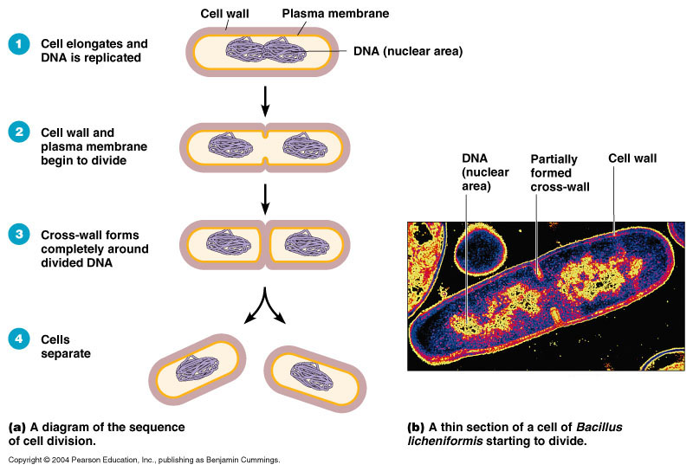
Significance of Sexual Reproduction
When prokaryotes reproduce asexually, they duplicate their genetic material and pass it on to daughter cells.
This process is efficient, but it yields daughter cells whose genomes duplicate their parent’s genome.
Genetic variation is basically restricted to mutations in DNA.

Slide 23
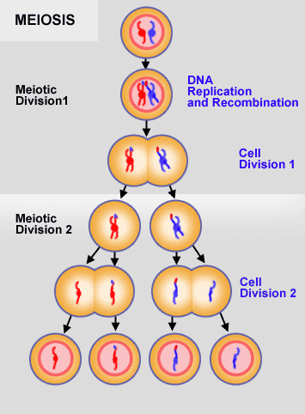
Significance of Sexual Reproduction
When eukaryotes reproduce sexually, offspring receive genetic material from two parents.
Meiosis and fertilization shuffle and reshuffle genes, generating lots of genetic diversity. The offspring of sexually reproducing organisms are never identical to either their parents or their siblings (except for identical twins).
Genetic variation increases the likelihood of a population’s adapting to new or changing environmental conditions.

Slide 24
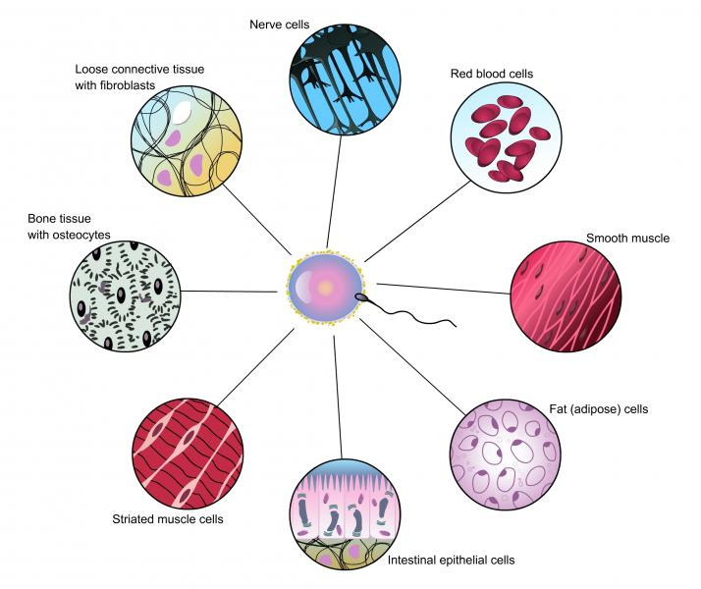
Multicellularity
Multicellular organisms evolved a few hundred million years after the evolution of sexual reproduction.
Early multicellular organisms likely underwent a series of adaptive radiations, resulting in great diversity.

