Slide 1
Quiz 12.2
What are the 4 bases in DNA (you may use their abbreviations)?
Is DNA single or double stranded?
What is Chargaff’s rule?

Slide 2
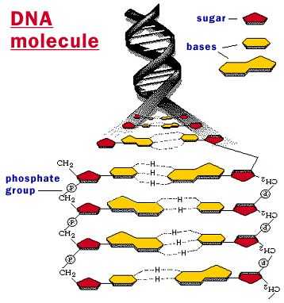
12.2 The Structure of DNA

Slide 3
Nucleic Acids and Nucleotides
Nucleic acids are long, slightly acidic molecules originally identified in cell nuclei.
Nucleic acids are made up of nucleotides, linked together to form long chains.
The nucleotides that make up DNA are shown.

Slide 4
Nucleic Acids and Nucleotides
DNA’s nucleotides are made up of three basic components: a 5-carbon sugar called deoxyribose, a phosphate group, and a nitrogenous base.

Slide 5
Nitrogenous Bases and Covalent Bonds
The nucleotides in a strand of DNA are joined by covalent bonds formed between their sugar and phosphate groups.

Slide 6
Nitrogenous Bases and Covalent Bonds
DNA has four kinds of nitrogenous bases: adenine (A), guanine (G), cytosine (C), and thymine (T).
The nitrogenous bases stick out sideways from the nucleotide chain.

Slide 7
Nitrogenous Bases and Covalent Bonds
The nucleotides can be joined together in any order, meaning that any sequence of bases is possible.

Slide 8
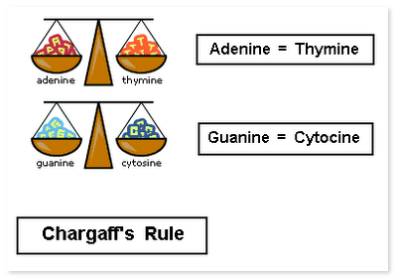
Chargaff’s Rules
Erwin Chargaff discovered that the percentages of adenine [A] and thymine [T] bases are almost equal in any sample of DNA.
The same thing is true for the other two nucleotides, guanine [G] and cytosine [C].
The observation that [A] = [T] and [G] = [C] became known as one of “Chargaff’s rules.”

Slide 9
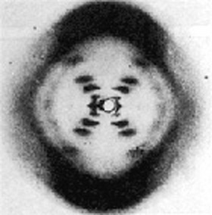
Franklin’s X-Rays
X-ray diffraction revealed an X-shaped pattern showing that the strands in DNA are twisted around each other like the coils of a spring.
The angle of the X-shaped pattern suggested that there are two strands in the structure.
Other clues suggest that the nitrogenous bases are near the center of the DNA molecule.

Slide 10
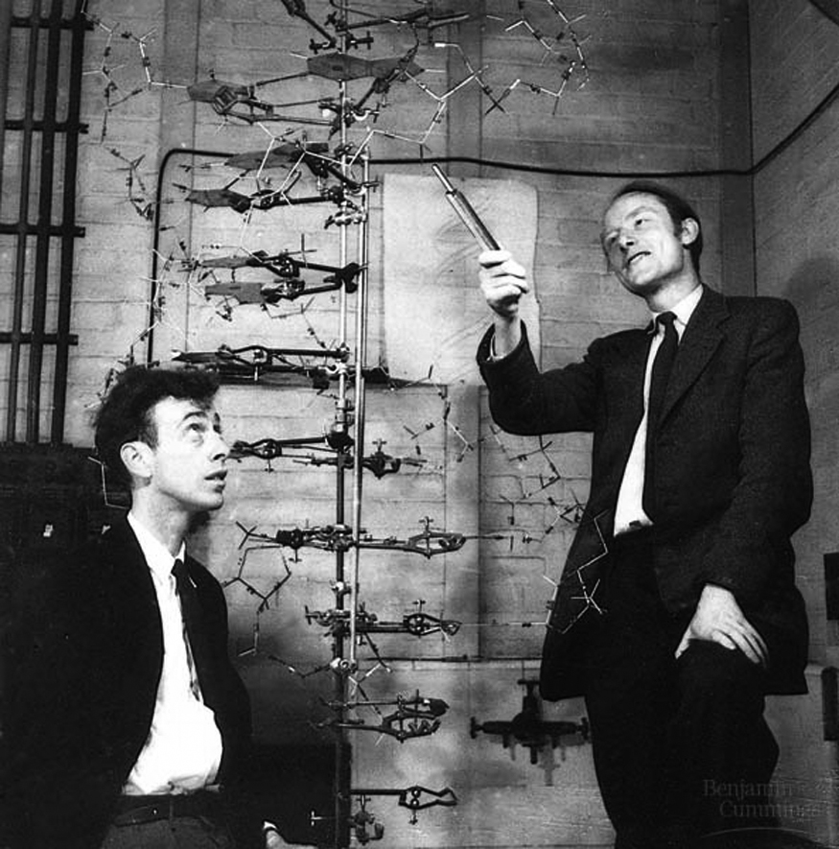
The Work of Watson and Crick
At the same time, James Watson, an American biologist, and Francis Crick, a British physicist, were also trying to understand the structure of DNA.
They built three-dimensional models of the molecule.

Slide 11
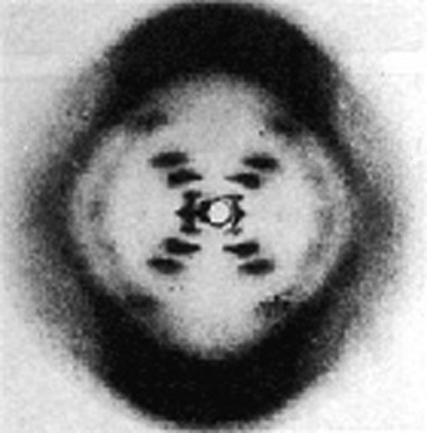
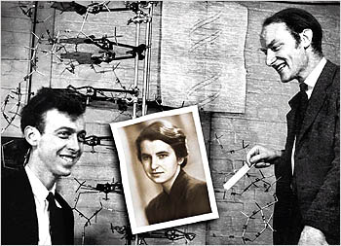
The Work of Watson and Crick
Early in 1953, Watson was shown a copy of Franklin’s X-ray pattern.
The clues in Franklin’s X-ray pattern enabled Watson and Crick to build a model that explained the specific structure and properties of DNA.

Slide 12
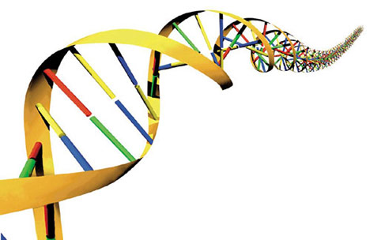
The Work of Watson and Crick
Watson and Crick’s breakthrough model of DNA was a double helix, in which two strands were wound around each other.

Slide 13
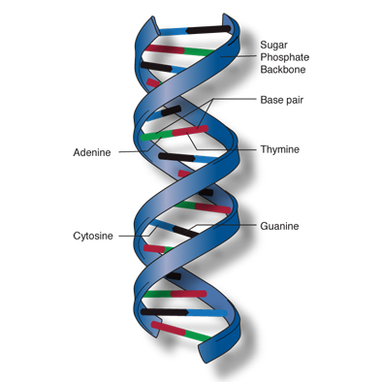
The Double-Helix Model
A double helix looks like a twisted ladder.
In the double-helix model of DNA, the two strands twist around each other like spiral staircases.
The double helix accounted for Franklin’s X-ray pattern and explains Chargaff’s rule of base pairing and how the two strands of DNA are held together.

Slide 14
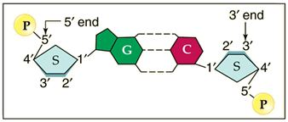
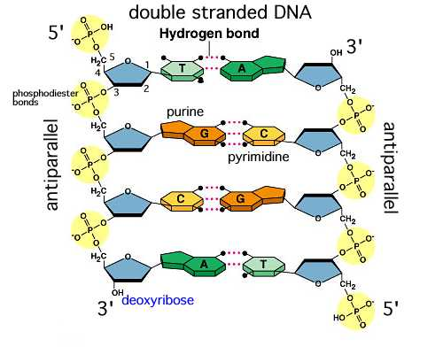
Antiparallel Strands
In the double-helix model, the two strands of DNA are “antiparallel”—they run in opposite directions.
This arrangement enables the nitrogenous bases on both strands to come into contact at the center of the molecule.
It also allows each strand of the double helix to carry a sequence of nucleotides, arranged almost like letters in a four-letter alphabet.

Slide 15
Hydrogen Bonding
Watson and Crick discovered that hydrogen bonds could form between certain nitrogenous bases, providing just enough force to hold the two DNA strands together.
Hydrogen bonds are relatively weak chemical forces that allow the two strands of the helix to separate.
The ability of the two strands to separate is critical to DNA’s functions.

Slide 16
Base Pairing
Watson and Crick’s model showed that hydrogen bonds could create a nearly perfect fit between nitrogenous bases along the center of the molecule.
These bonds would form only between certain base pairs—adenine with thymine, and guanine with cytosine.
This nearly perfect fit between A–T and G–C nucleotides is known as base pairing, and is illustrated in the figure.

Slide 17
Base Pairing
Watson and Crick realized that base pairing explained Chargaff’s rule. It gave a reason why [A] = [T] and [G] = [C].
For every adenine in a double-stranded DNA molecule, there had to be exactly one thymine. For each cytosine, there was one guanine.

Slide 18
DNA Videos
http://www.dailymotion.com/video/x7u41g_dna_tech
http://www.youtube.com/watch?v=4PKjF7OumYo
http://videos.howstuffworks.com/discovery/28756-assignment-discovery-cell-dna-video.htm
http://www.youtube.com/watch?v=8kK2zwjRV0M
http://www.youtube.com/watch?v=V9BZ3zx8b8I

