Slide 1
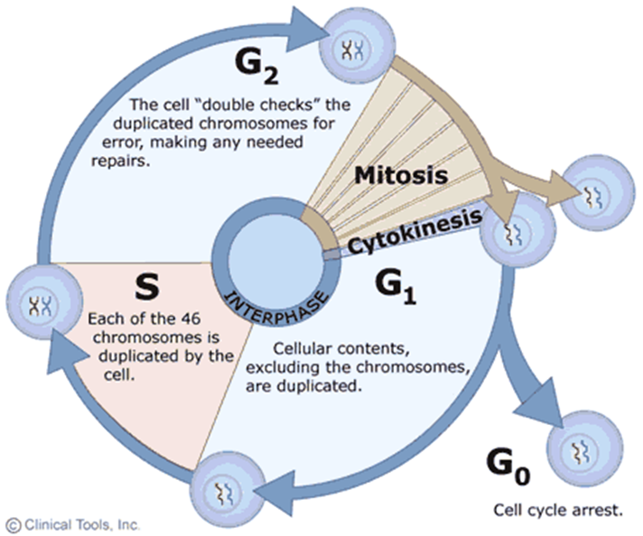
10.3 Regulating the Cell Cycle

Slide 2
Regulating the Cell Cycle
The controls on cell growth and division can be turned on and off.
For example, when an injury such as a broken bone occurs, cells are stimulated to divide rapidly and start the healing process. The rate of cell division slows when the healing process nears completion.

Slide 3
The Discovery of Cyclins
Cyclins are a family of proteins that regulate the timing of the cell cycle in eukaryotic cells.
This graph shows how cyclin levels change throughout the cell cycle in fertilized clam eggs.

Slide 4
Regulatory Proteins
Internal regulators are proteins that respond to events inside a cell. They allow the cell cycle to proceed only once certain processes have happened inside the cell.
External regulators are proteins that respond to events outside the cell. They direct cells to speed up or slow down the cell cycle.
Growth factors are external regulators that stimulate the growth and division of cells. They are important during embryonic development and wound healing.

Slide 5
Cancer: Uncontrolled Cell Growth
Cancer cells do not respond to the signals that regulate the growth of most cells. As a result, the cells divide uncontrollably.

Slide 6
Cancer: Uncontrolled Cell Growth
Cancer is a disorder in which body cells lose the ability to control cell growth.
Cancer cells divide uncontrollably to form a mass of cells called a tumor.

Slide 7
Cancer: Uncontrolled Cell Growth
A benign tumor is noncancerous. It does not spread to surrounding healthy tissue.
A malignant tumor is cancerous. It invades and destroys surrounding healthy tissue and can spread to other parts of the body. The spread of cancer cells is called metastasis. Cancer cells absorb nutrients needed by other cells, block nerve connections, and prevent organs from functioning.

Slide 8
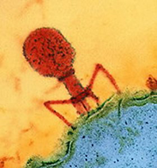
What Causes Cancer?
Cancers are caused by defects in genes that regulate cell growth and division.
Some sources of gene defects are smoking tobacco, radiation exposure, defective genes, and viral infection.
A damaged or defective p53 gene is common in cancer cells. It causes cells to lose the information needed to respond to growth signals.

Slide 9
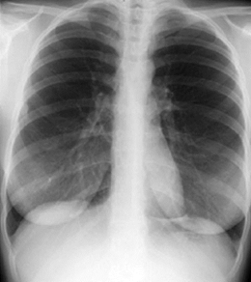
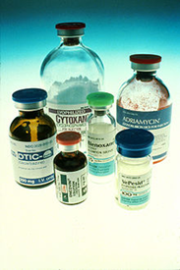
Treatments for Cancer
Some localized tumors can be removed by surgery.
Many tumors can be treated with targeted radiation.
Chemotherapy is the use of compounds that kill or slow the growth of cancer cells.

