Slide 1
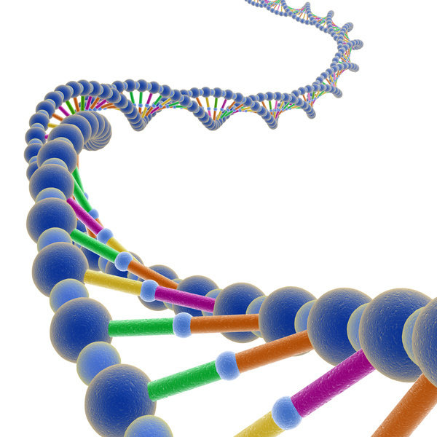
Chapter 12 DNA

Slide 2
Chapter 12-2: DNA
12-2
Describe the structure of DNA
Objectives:
Explain complimentary base pairing

Slide 3
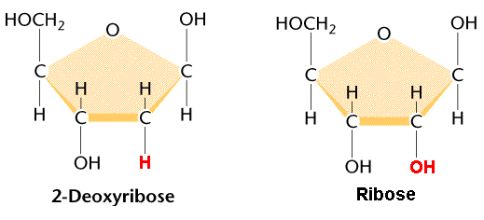
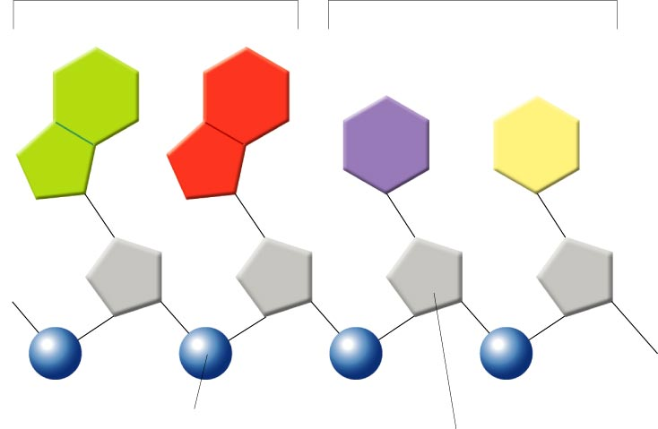
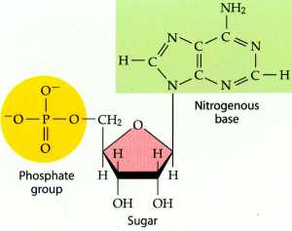
Structure of DNA
12-2
DNA = deoxyribonucleic acid
DNA is a nucleic acid polymer of nucleotides
Nucleotides are made up of a
Deoxyribose sugar
Phosphate group
Nitrogenous base
Nitrogenous base
Nucleotide
Phosphate group
Deoxyribose

Slide 4
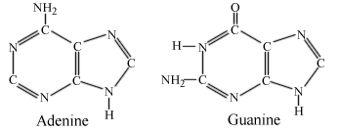
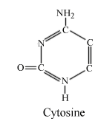
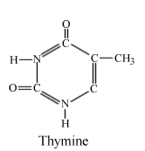
Structure of DNA
12-2
Purines
Pyrimidines
4 nitrogenous bases
2 purines
Adenine
Guanine
2 pyrimidines
Cytosine
Thymine
Purines have two rings in their structure, pyrimidines have one
A
G
C
T
Phosphate group
Deoxyribose

Slide 5
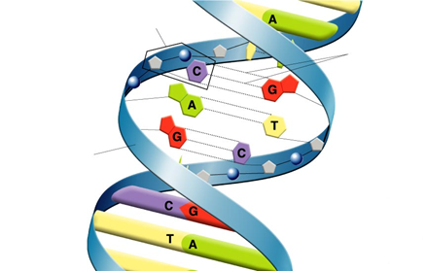
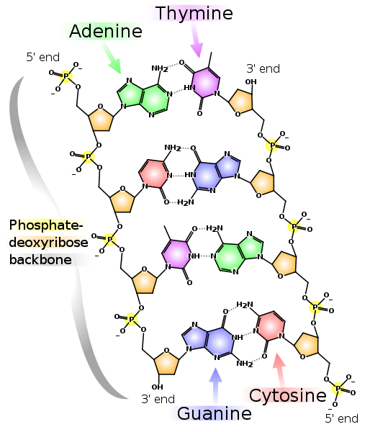
Structure of DNA
12-2
Nucleotide
Hydrogen bonds
DNA has two strands arranged in a double helix
“twisted ladder”
Sugar-phosphate backbone
Nitrogenous bases are the rungs of the ladder
Strands are held together by hydrogen bonds
Sugar-phosphate backbone

Slide 6
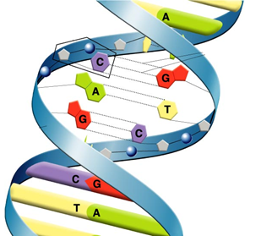
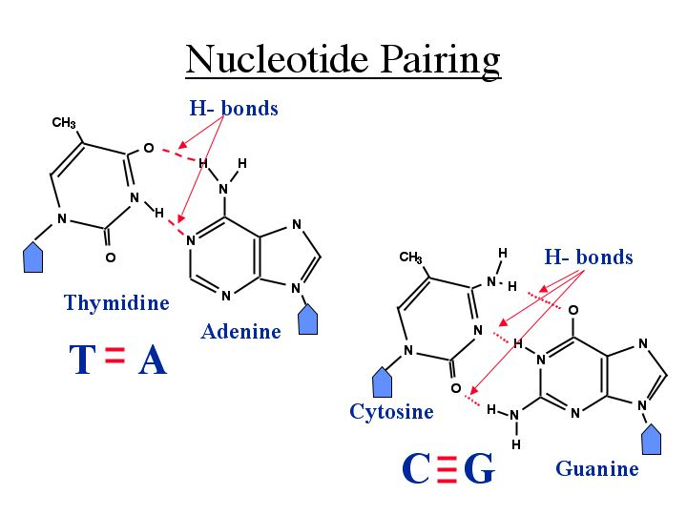
Base Pairing
12-2
Guanine always bonds to Cytosine
G-C
Adenine always bonds to thymine
A-T
Note that each purine has a complimentary pyrimidine
If the sequence of one strand was AAGCTTCGA what would the complimentary be?

Slide 7
Chapter 12-3: Chromosomes and DNA Replication
12-3
Link DNA and chromosomes
Objectives:
Explain the process of DNA replication

Slide 8
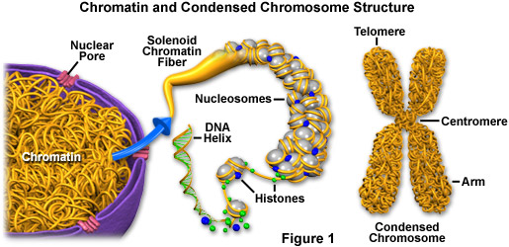
Chromosome Structure
12-3
DNA must be tightly coiled and compressed in order to fit in a cell
A cell’s DNA is ~600,000 times longer than the cell itself!
Chromosomes are made up of chromatin
DNA and proteins called histones
Nucleosomes are spooled units of DNA wrapped around histones

Slide 9
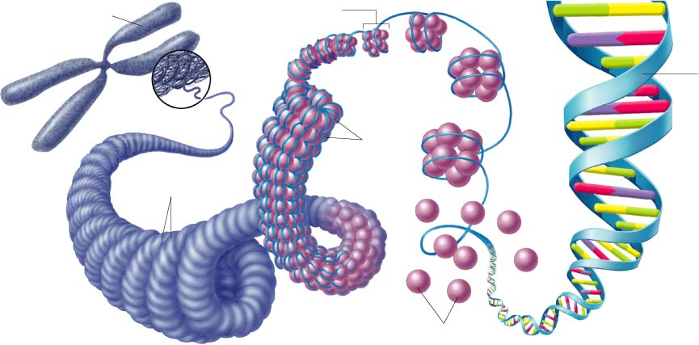
12-3
Chromosome
Nucleosome
DNA
double
helix
Coils
Supercoils
Histones

Slide 10
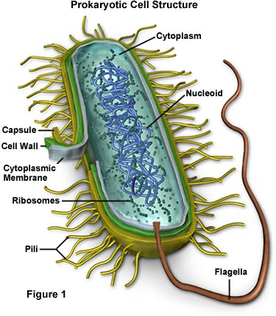
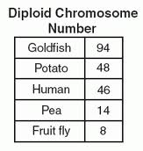
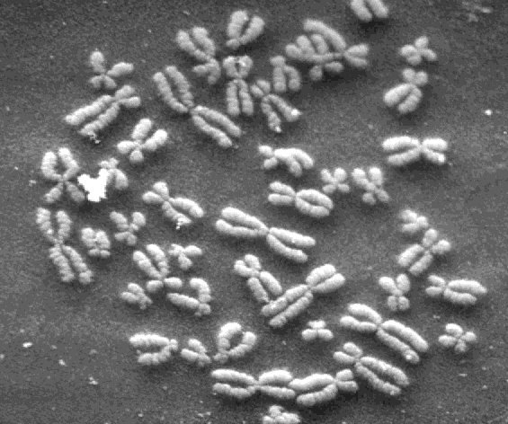
Eukaryotic vs. Prokaryotic Chromosomes
12-3
Prokaryotes have a single chromosome
Eukaryotes have multiple chromosomes
~1000x more DNA than prokaryotes

Slide 11
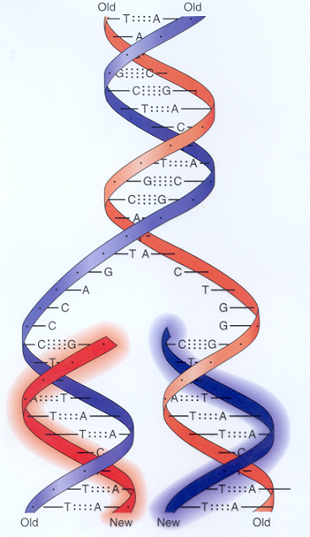
DNA Replication
12-3
Before a cell divides its DNA must be copied in a process called replication
Ensures that each cell has a complete set of DNA
Based on complementary base pairing
The double helix is separated and each strand becomes the template for a new double helix

Slide 12
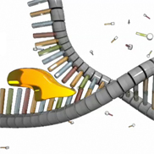
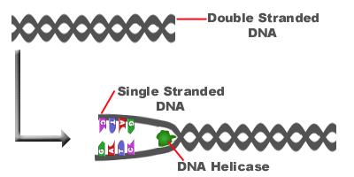
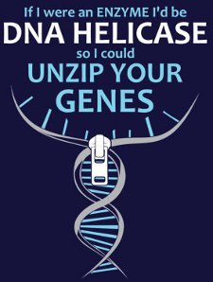
DNA Replication Step 1
12-3
The DNA strand is unzipped by the enzyme DNA helicase
Hydrogen bonds are broken

Slide 13
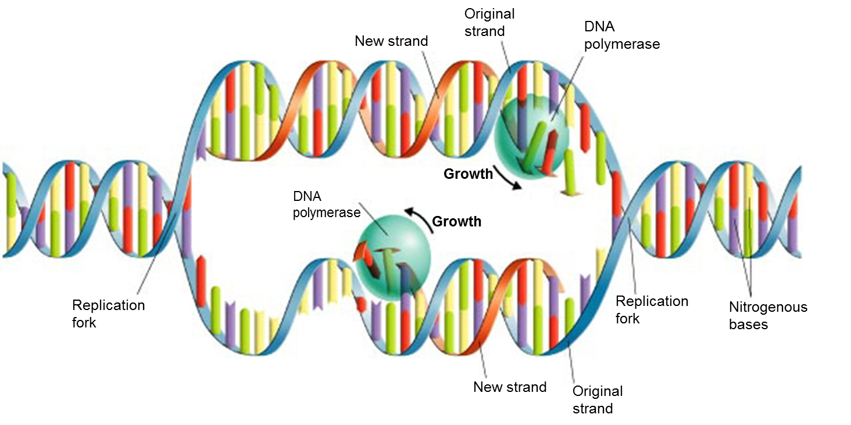
DNA Replication Step 2
12-3
The enzyme DNA polymerase adds complementary nucleotides to the exposed strands

Slide 14
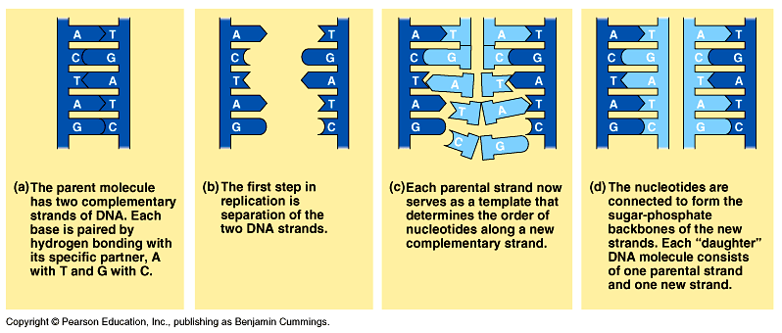
12-3
DNA Replication Summary

