Slide 1
Cellular Processes
Ch. 8 and 9

Slide 2
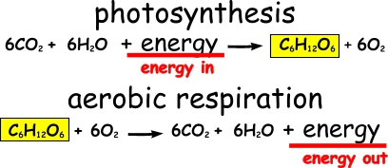
Equations

Slide 3
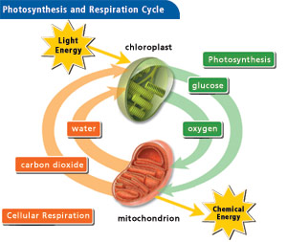

Slide 4
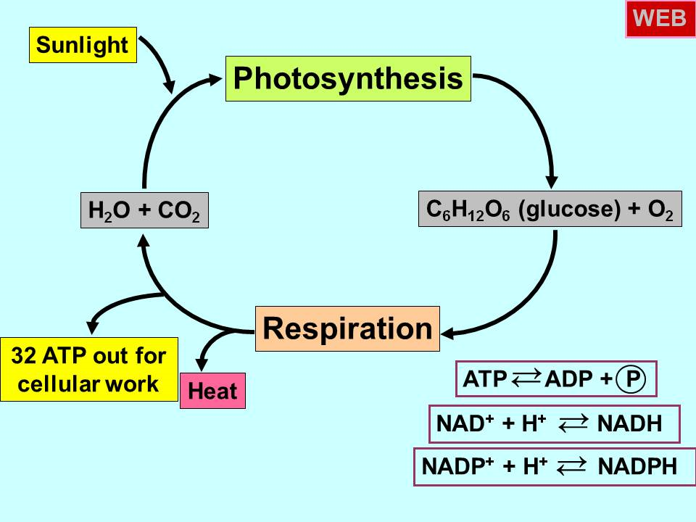

Slide 5
Basic Functions of Photosynthesis
To convert the energy from the sun into chemical energy for food.
With the exception of certain plants utilizing chemosynthesis, all plants and animals in Earth's ecosystem are ultimately dependent on the sugars and carbohydrates produced by plants through photosynthesis.

Slide 6
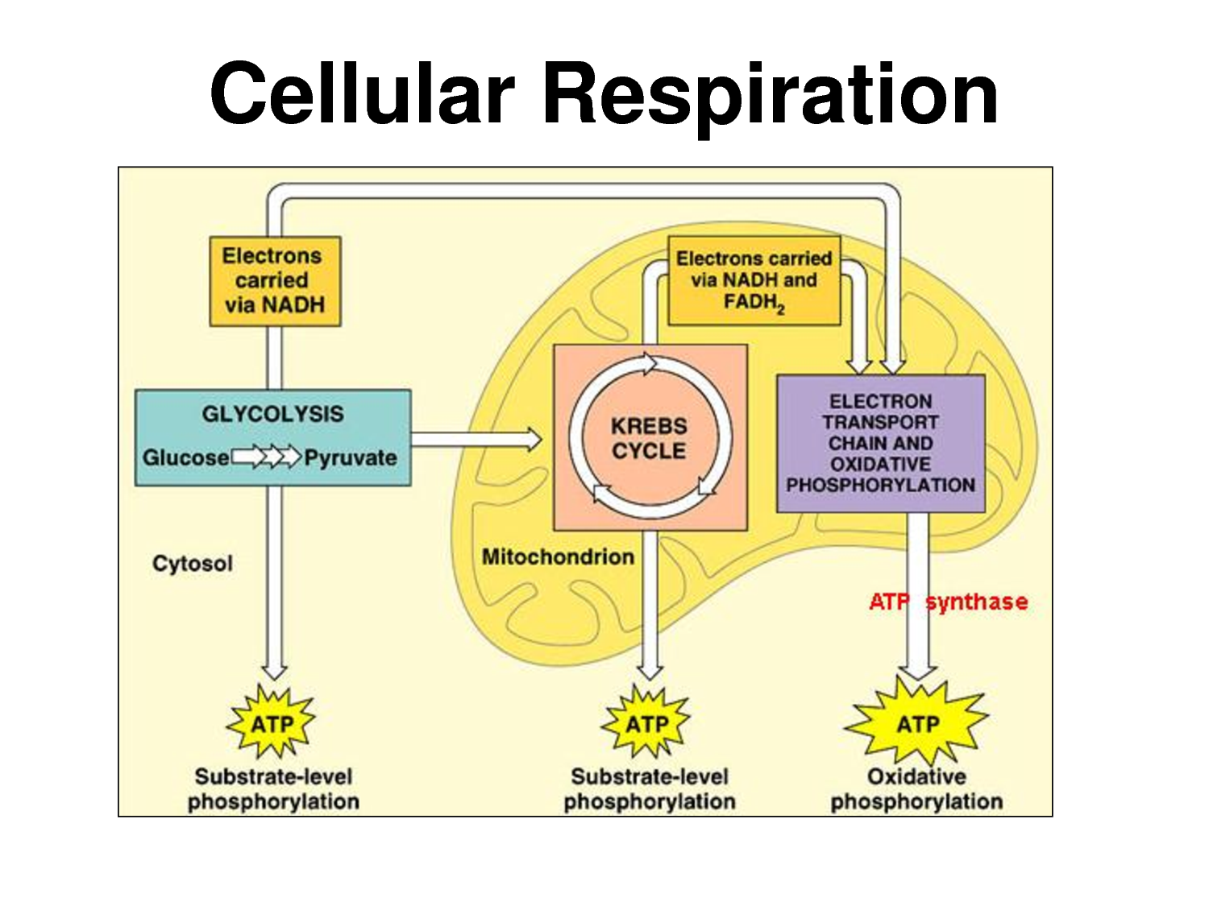
Basic Function of Cellular Respiration
to break down molecules and generate ATP

Slide 7
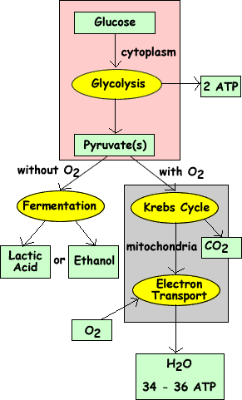

Slide 8
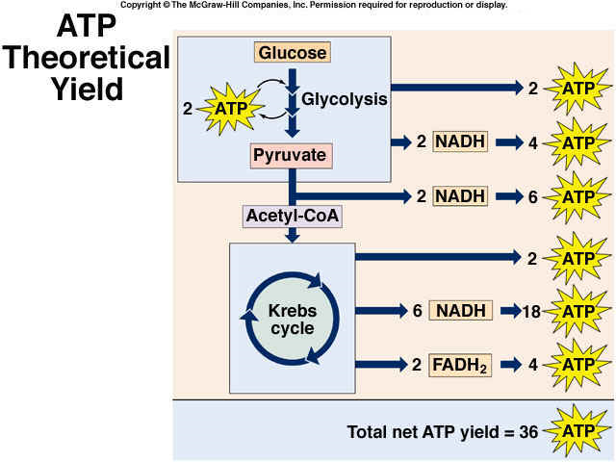

Slide 9
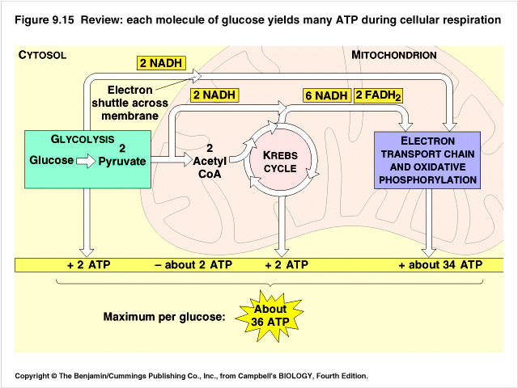

Slide 10
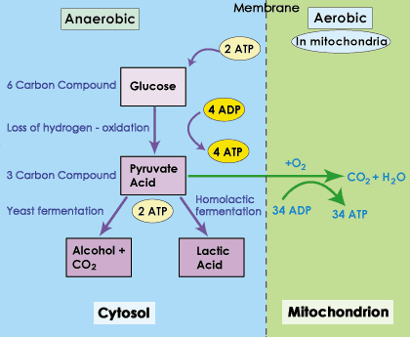
What if there’s NO oxygen?

Slide 11
Youtube Video Review
Photosynthesis:
http://www.youtube.com/watch?v=4CK4z4MDXuE
http://www.youtube.com/watch?v=6GugfL45XHE
http://www.youtube.com/watch?v=pE82qtKSSH4

Slide 12
Youtube Video Review
Cellular Respiration:
http://www.youtube.com/watch?v=3aZrkdzrd04
http://www.youtube.com/watch?v=V_xZuCPIHvk&feature=related
http://www.youtube.com/watch?v=1TGg6KyOwc0&feature=related
http://www.youtube.com/watch?v=fVSyjMNOqww&feature=related

Slide 13
Youtube Review: Each cycle in cellular respiration
Glycolysis:
http://www.youtube.com/watch?v=evYmyHgj550&feature=fvwrel
http://www.youtube.com/watch?v=iwBJ4mmm5NI&feature=fvwrel
Kreb’s Cycle:
http://www.youtube.com/watch?v=DN7Cwqp4TxE&feature=fvwrel
http://www.youtube.com/watch?v=FgXnH087JIk&feature=related
Electron Transport Chain:
http://www.youtube.com/watch?v=twSymOPedeM
http://www.youtube.com/watch?v=m-tNZ9SpDs4&feature=related

Slide 14
Youtube Video Review
Anaerobic respiration:
http://www.youtube.com/watch?v=Kdpm1OL6nS0
http://www.youtube.com/watch?v=tSZQlMSMrr0
http://www.youtube.com/watch?v=Og1n44WOyY0

Slide 15
Review Games!
Photosynthesis: Who wants to be a millionaire?
http://www.quia.com/rr/216175.html
Photosynthesis Review: basketball game
http://sciencereviewgames.com/srg/games/hs.php?id=133
Cellular Respiration: Who wants to be a millionaire?
http://www.quia.com/rr/216170.html
Photosynthesis and Cellular Respiration Review game:
http://reviewgamezone.com/game.php?id=3056
this link has LOTS of games for kids to play

