Slide 1
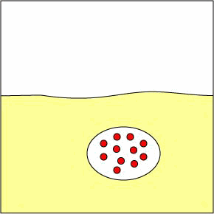
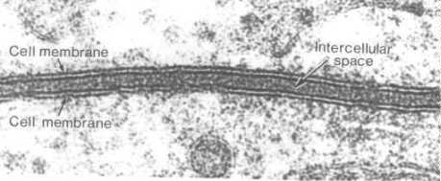
Cellular Transport

Slide 2
S7L2. Students will describe the structure and function of cells, tissues, organs, and organ systems.
Explain that cells take in nutrients in order to grow and divide and to make needed materials.
Relate cell structures (cell membrane, nucleus, cytoplasm, chloroplasts, mitochondria) to basic cell functions.
Explain that cells are organized into tissues, tissues into organs, organs into systems, and systems into organisms.
Explain that tissues, organs, and organ systems serve the needs cells have for oxygen, food, and waste removal.

Slide 3
Terms to Know
Concentration – the amount of solute in a solution.
Solute – the dissolved substance in a solution.
Solution – a mixture in which two or more substances are mixed evenly.
Concentration gradient - the gradual difference in the concentration of solutes in a solution between two regions.

Slide 4
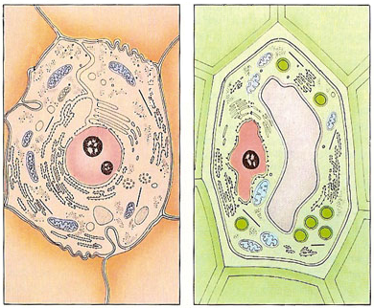
Cell Membrane (Transport) Notes
Cell Membrane and Cell Wall:
ALL cells have a cell membrane made of proteins and lipids
protein channel
Cell Membrane
Layer 1
Layer 2
SOME cells have cell membranes and cell walls – ex: plants, fungi and bacteria
lipid bilayer
protein pump
Cell Membrane
Cell Wall

Slide 5
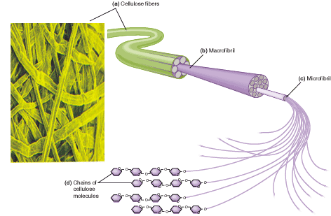
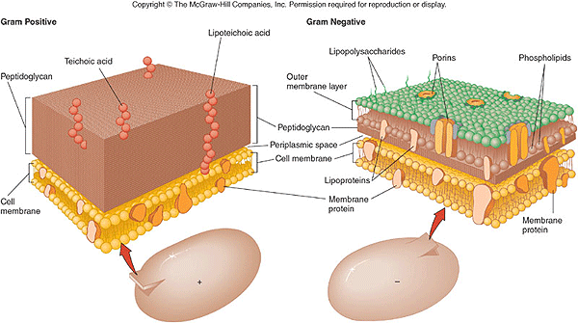
Plant cells have a cell wall made of cellulose – that cellulose is fiber in our diet
Bacteria and fungi also have cell walls, but they do not contain cellulose
Cell membranes and cell walls are porous allowing water, carbon dioxide, oxygen and nutrients to pass through easily

Slide 6
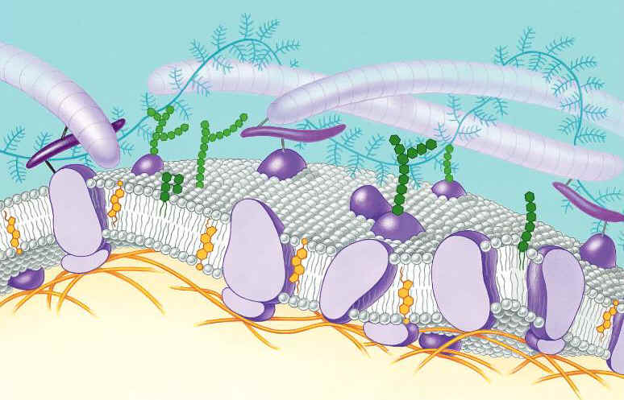
Function of the Cell Membrane:
Cell membrane separates the components of a cell from its environment—surrounds the cell
“Gatekeeper” of the cell—regulates the flow of materials into and out of cell—selectively permeable
Cell membrane helps cells maintain homeostasis—stable internal balance

Slide 7
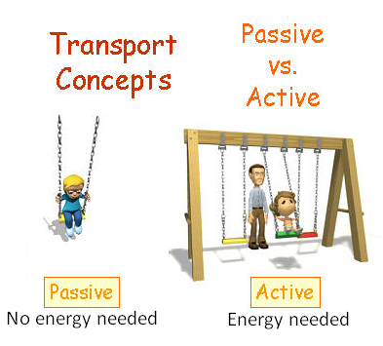

Slide 8
Types of Cellular Transport
Animations of Active Transport & Passive Transport
Weeee!!!
Passive Transport
cell doesn’t use energy
Diffusion
Facilitated Diffusion
Osmosis
Active Transport
cell does use energy
Protein Pumps
Endocytosis
Exocytosis
high
low
This is gonna be hard work!!
high
low

Slide 9
Diffusion is the movement of small particles across a selectively permeable membrane like the cell membrane until equilibrium is reached.
These particles move from an area of high concentration to an area of low concentration.
outside of cell
inside of cell

Slide 10
Diffusion
HIGH to LOW concentration

Slide 11
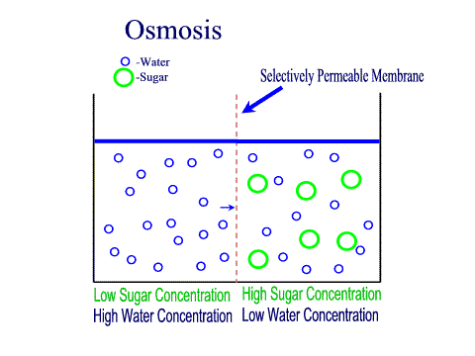
Osmosis is the diffusion of water through a selectively permeable membrane like the cell membrane
Water diffuses across a membrane from an area of high concentration to an area of low concentration.
Semi-permeable membrane is permeable to water, but not to sugar

Slide 12
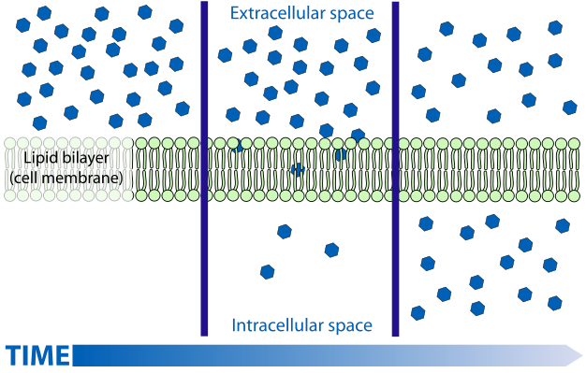

Slide 13
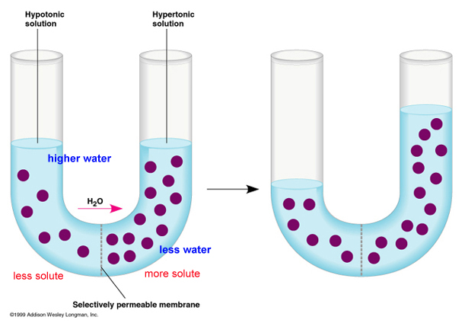

Slide 14
Facilitated Diffusion is the movement of larger molecules like glucose through the cell membrane – larger molecules must be “helped”
Proteins in the cell membrane form channels for large molecules to pass through
Proteins that form channels (pores) are called protein channels
Glucose molecules
outside of cell
inside of cell

Slide 15
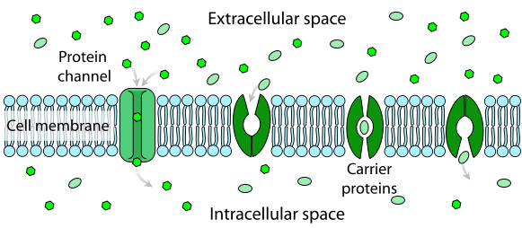
Click

Slide 16
Hypertonic Solutions: contain a high concentration of solute relative to another solution (e.g. the cell's cytoplasm). When a cell is placed in a hypertonic solution, the water diffuses out of the cell, causing the cell to shrivel.
Hypotonic Solutions: contain a low concentration of solute relative to another solution (e.g. the cell's cytoplasm). When a cell is placed in a hypotonic solution, the water diffuses into the cell, causing the cell to swell and possibly explode.
Isotonic Solutions: contain the same concentration of solute as another solution (e.g. the cell's cytoplasm). When a cell is placed in an isotonic solution, the water diffuses into and out of the cell at the same rate. The fluid that surrounds the body cells is isotonic.

Slide 17
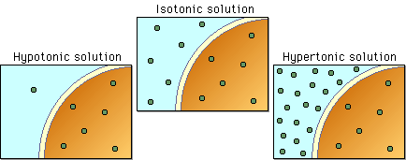

Slide 18
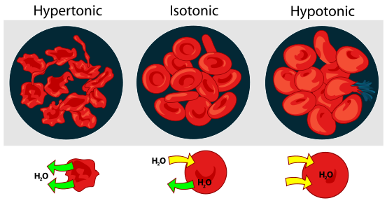
Interactive Red Blood Cell
Click

Slide 19
Active Transport
Active transport is the movement of molecules from LOW to HIGH concentration.
Energy is required as molecules must be pumped against the concentration gradient.
Proteins that work as pumps are called protein pumps.
Ex: Body cells must pump carbon dioxide out into the surrounding blood vessels to be carried to the lungs for exhale. Blood vessels are high in carbon dioxide compared to the cells, so energy is required to move the carbon dioxide across the cell membrane from LOW to HIGH concentration.
outside of cell
Carbon Dioxide molecules
inside of cell

Slide 20
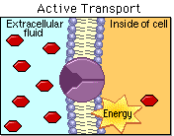

Slide 21
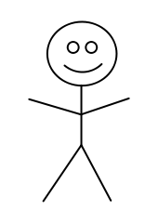
ANALOGY:
ENERGY NEEDED:
Active Transport
NO ENERGY NEEDED:
Diffusion
Osmosis
Facilitated Diffusion

Slide 22
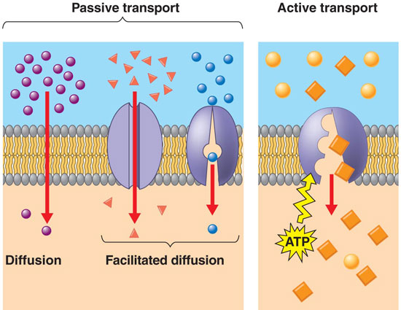

Slide 23
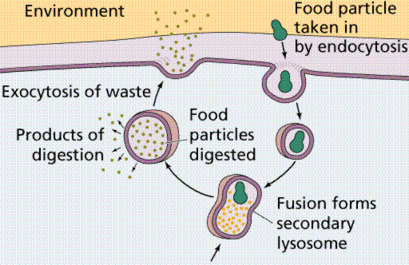
Endocytosis and Exocytosis is the mechanism by which very large molecules (such as food and wastes) get into and out of the cell
Food is moved into the cell by Endocytosis
Wastes are moved out of the cell by Exocytosis

Slide 24
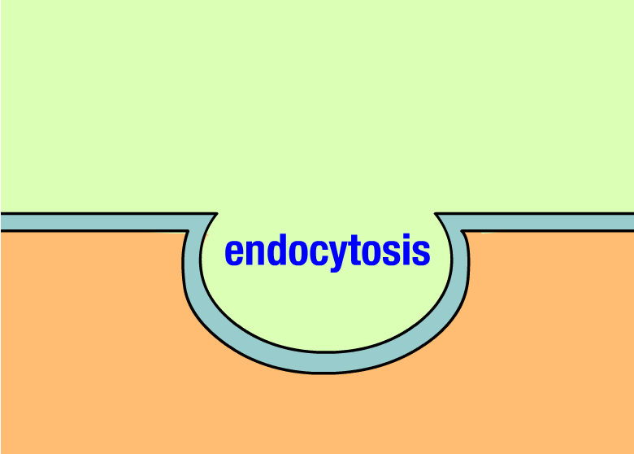

Slide 25
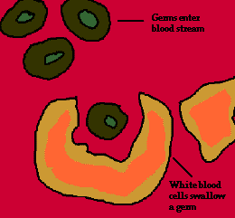
Ex: White Blood Cells, which are part of the immune system, surround and engulf bacteria by endocytosis.

Slide 26
Types of Active Transport
3. Exocytosis: Forces material out of cell in bulk
membrane surrounding the material fuses with cell membrane
Cell changes shape – requires energy
EX: Hormones or wastes released from cell
Endocytosis & Exocytosis animations

Slide 27
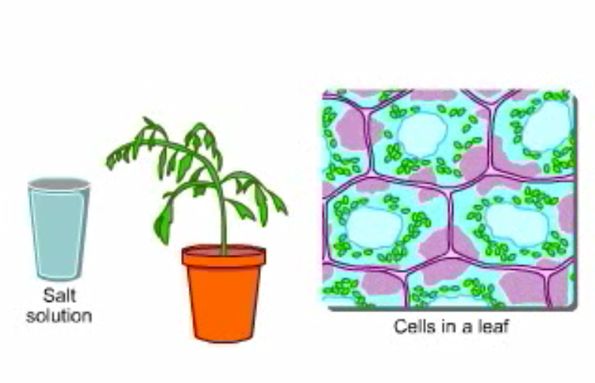
Osmosis—Elodea Leaf

Slide 28
Effects of Osmosis on Life
Osmosis- diffusion of water through a selectively permeable membrane
Water is so small and there is so much of it the cell can’t control it’s movement through the cell membrane.

Slide 29
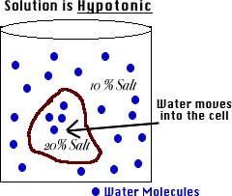
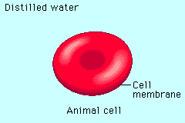
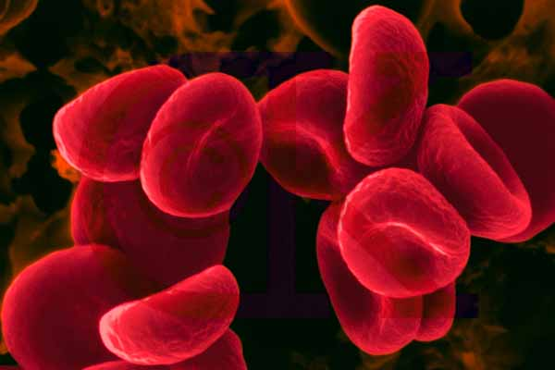
Hypotonic Solution
Osmosis Animations for isotonic, hypertonic, and hypotonic solutions
Hypotonic: The solution has a lower concentration of solutes and a higher concentration of water than inside the cell. (Low solute; High water)
Result: Water moves from the solution to inside the cell): Cell Swells and bursts open (cytolysis)!

Slide 30
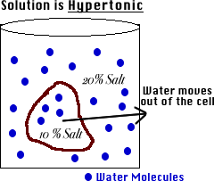
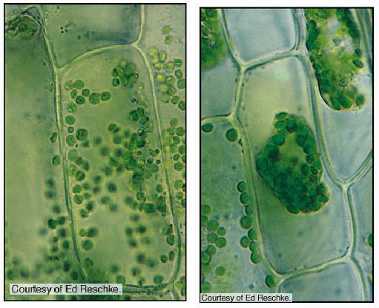
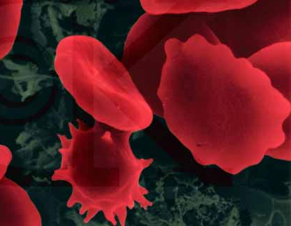
Hypertonic Solution
Osmosis Animations for isotonic, hypertonic, and hypotonic solutions
Hypertonic: The solution has a higher concentration of solutes and a lower concentration of water than inside the cell. (High solute; Low water)
shrinks
Result: Water moves from inside the cell into the solution: Cell shrinks (Plasmolysis)!

Slide 31
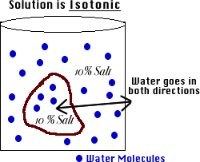
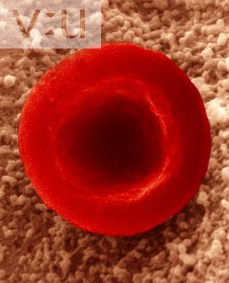
Isotonic Solution
Osmosis Animations for isotonic, hypertonic, and hypotonic solutions
Isotonic: The concentration of solutes in the solution is equal to the concentration of solutes inside the cell.
Result: Water moves equally in both directions and the cell remains same size! (Dynamic Equilibrium)

Slide 32
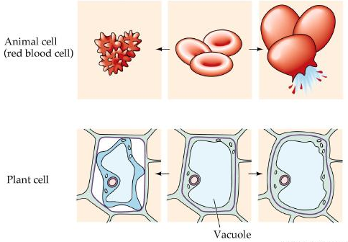
What type of solution are these cells in?
A
B
C
Hypertonic
Isotonic
Hypotonic

Slide 33
How Organisms Deal with Osmotic Pressure
Paramecium (protist) removing excess water video
Bacteria and plants have cell walls that prevent them from over-expanding. In plants the pressure exerted on the cell wall is called tugor pressure.
A protist like paramecium has contractile vacuoles that collect water flowing in and pump it out to prevent them from over-expanding.
Salt water fish pump salt out of their specialized gills so they do not dehydrate.
Animal cells are bathed in blood. Kidneys keep the blood isotonic by remove excess salt and water.

