Slide 1
Bellringer
Which of the following tissues is a tissue type found at the apex of roots and shoots?
a) epidermal tissue
b) ground tissue
c) meristematic tissue
d) vascular tissue

Slide 2
To Be Answered…
THINK:
How many cells are you composed of?
When an organism grows bigger do you get more cells or just bigger cells or both?
When do your cells divide the fastest? Slowest?
Do cells ever stop dividing?
Are all cells capable of division and replacement?
Notes:
Thanks to person who introduced me
Explain presentation style
Different, wacky, interactive
Reason for madness- will be reviewed during implications
May be asked to be an active participant
May be asked to reinforce others
Will be reinforced with candy
Comments/questions welcomed throughout
Reinforce me for doing well
Have participants guess the number of new things they will learn today

Slide 3
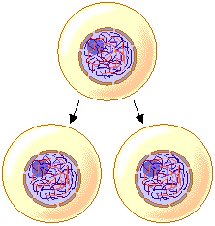
Mitosis:
The Great Divide
05/04
Notes:
Thanks to person who introduced me
Explain presentation style
Different, wacky, interactive
Reason for madness- will be reviewed during implications
May be asked to be an active participant
May be asked to reinforce others
Will be reinforced with candy
Comments/questions welcomed throughout
Reinforce me for doing well
Have participants guess the number of new things they will learn today

Slide 4
Why Would a Cell Divide?
As cells absorb nutrients and get larger, the volume of the cell increases faster than the surface area
This means that a cell can no longer absorb nutrients and get rid of wastes fast enough to support its demands (volume)
So what’s a cell to do?
  Solution: divide in 2!
Surface area for exchange not great enough to support cell’s needs
Notes:
Thanks to person who introduced me
Explain presentation style
Different, wacky, interactive
Reason for madness- will be reviewed during implications
May be asked to be an active participant
May be asked to reinforce others
Will be reinforced with candy
Comments/questions welcomed throughout
Reinforce me for doing well
Have participants guess the number of new things they will learn today

Slide 5
When Would a Cell Divide?
Growth
Repair or Replacement
Cancer
Different cells divide at different rates:
Most mammalian cells = 12-24 hours
Some bacterial cells = 20-30 minutes
Notes:
Thanks to person who introduced me
Explain presentation style
Different, wacky, interactive
Reason for madness- will be reviewed during implications
May be asked to be an active participant
May be asked to reinforce others
Will be reinforced with candy
Comments/questions welcomed throughout
Reinforce me for doing well
Have participants guess the number of new things they will learn today

Slide 6
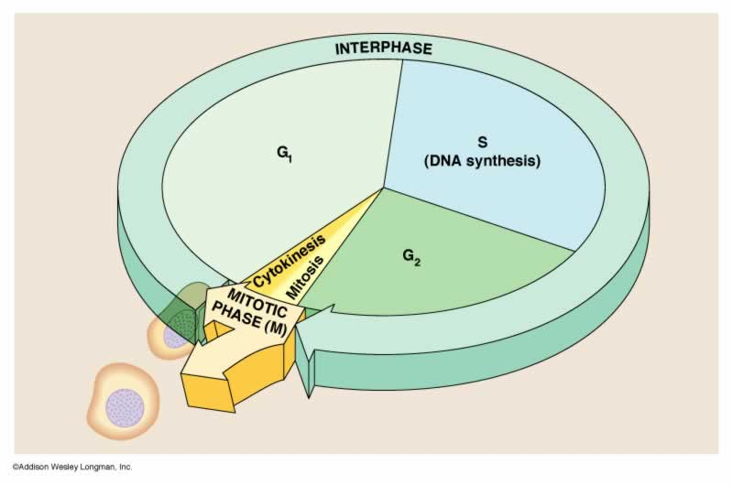
The Cell Cycle
Notes:
Thanks to person who introduced me
Explain presentation style
Different, wacky, interactive
Reason for madness- will be reviewed during implications
May be asked to be an active participant
May be asked to reinforce others
Will be reinforced with candy
Comments/questions welcomed throughout
Reinforce me for doing well
Have participants guess the number of new things they will learn today

Slide 7
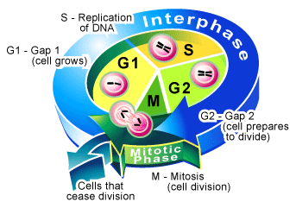
Stages of the Cell Cycle
2 stages = interphase (growth & replication of DNA) & mitotic phase (division of cell into 2 daughter cells)
Cell spends about 90% of the time in interphase
Notes:
Thanks to person who introduced me
Explain presentation style
Different, wacky, interactive
Reason for madness- will be reviewed during implications
May be asked to be an active participant
May be asked to reinforce others
Will be reinforced with candy
Comments/questions welcomed throughout
Reinforce me for doing well
Have participants guess the number of new things they will learn today

Slide 8
Interphase
Divided into 3 phases:
  G1 (1st gap) = small cell is absorbing nutrients, growing & doing its job (i.e. making proteins)
  S (synthesis) = cell is continuing to grow & duplicates its DNA (i.e. chromosomes) in preparation for making duplicate cells during mitosis
  G2 (2nd gap) = cell keeps growing & doing its job (i.e. making proteins); it grows too big…solution = divide in 2
Notes:
Thanks to person who introduced me
Explain presentation style
Different, wacky, interactive
Reason for madness- will be reviewed during implications
May be asked to be an active participant
May be asked to reinforce others
Will be reinforced with candy
Comments/questions welcomed throughout
Reinforce me for doing well
Have participants guess the number of new things they will learn today

Slide 9

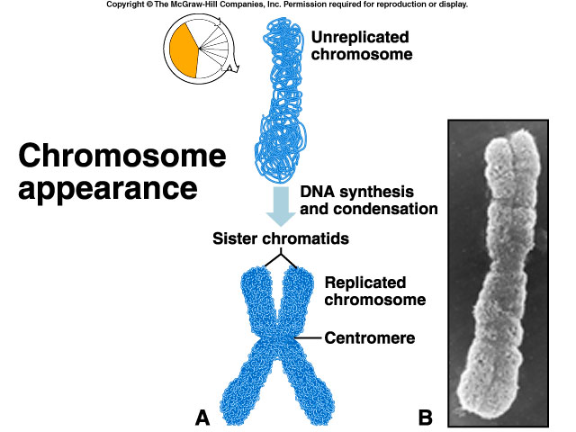
Mitosis: A Closer Look
Interphase
Prior to entering the mitotic phase, the cell has just come out of interphase
  Replicated DNA during S (synthesis)
  2 complete sets of chromosomes that must be distributed equally between 2 cells = mitosis
Notes:
Thanks to person who introduced me
Explain presentation style
Different, wacky, interactive
Reason for madness- will be reviewed during implications
May be asked to be an active participant
May be asked to reinforce others
Will be reinforced with candy
Comments/questions welcomed throughout
Reinforce me for doing well
Have participants guess the number of new things they will learn today

Slide 10
The Mitotic Phase
Equal distribution of 2 sets of chromosomes (DNA) into 2 identical daughter cells
Divided into 4 stages of Mitosis:
  Prophase
  Metaphase
  Anaphase
  Telophase
Cytokinesis
Notes:
Thanks to person who introduced me
Explain presentation style
Different, wacky, interactive
Reason for madness- will be reviewed during implications
May be asked to be an active participant
May be asked to reinforce others
Will be reinforced with candy
Comments/questions welcomed throughout
Reinforce me for doing well
Have participants guess the number of new things they will learn today

Slide 11
Cell Cycle Tidbits
How long is one cell cycle?
  Depends on the cell- skin cells = ~24 hours, nerve cells = never after maturity, cancer cells = very short
  Remember: every cell only has a certain # of divisions it can undergo, then it dies = apoptosis (programmed cell death)
Notes:
Thanks to person who introduced me
Explain presentation style
Different, wacky, interactive
Reason for madness- will be reviewed during implications
May be asked to be an active participant
May be asked to reinforce others
Will be reinforced with candy
Comments/questions welcomed throughout
Reinforce me for doing well
Have participants guess the number of new things they will learn today

Slide 12

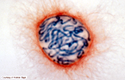
Prophase
Chromatin condenses visible chromosomes
  Appear as sister chromatids held together by centromere
Nuclear membrane dissolves
The centrioles migrate to opposite poles & spindle fibers form between them
        http://www.biostudio.com/demo_freeman_dna_coiling.htm
Notes:
Thanks to person who introduced me
Explain presentation style
Different, wacky, interactive
Reason for madness- will be reviewed during implications
May be asked to be an active participant
May be asked to reinforce others
Will be reinforced with candy
Comments/questions welcomed throughout
Reinforce me for doing well
Have participants guess the number of new things they will learn today

Slide 13

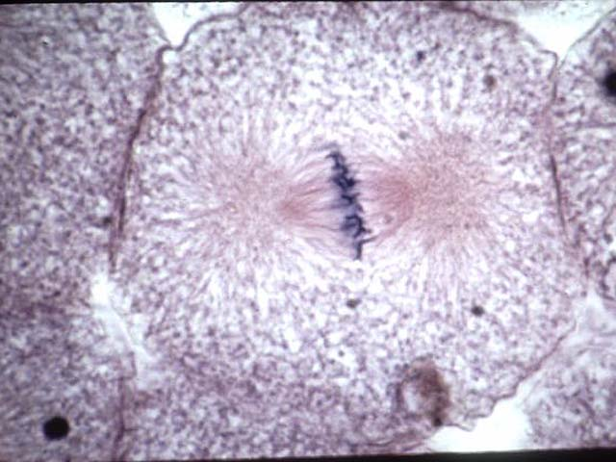
Metaphase
Chromosomes line-up on the metaphase plate
Centromeres are attached to spindle fibers
Notes:
Thanks to person who introduced me
Explain presentation style
Different, wacky, interactive
Reason for madness- will be reviewed during implications
May be asked to be an active participant
May be asked to reinforce others
Will be reinforced with candy
Comments/questions welcomed throughout
Reinforce me for doing well
Have participants guess the number of new things they will learn today

Slide 14

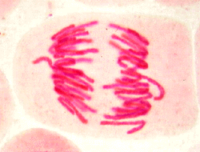
Anaphase
Centromeres divide
Spindle fibers contract
Result = sister chromatids are pulled away from one another towards the poles
Notes:
Thanks to person who introduced me
Explain presentation style
Different, wacky, interactive
Reason for madness- will be reviewed during implications
May be asked to be an active participant
May be asked to reinforce others
Will be reinforced with candy
Comments/questions welcomed throughout
Reinforce me for doing well
Have participants guess the number of new things they will learn today

Slide 15


Telophase
The chromosomes reach the poles
Nuclear membranes form around the 2 new nuclei
Notes:
Thanks to person who introduced me
Explain presentation style
Different, wacky, interactive
Reason for madness- will be reviewed during implications
May be asked to be an active participant
May be asked to reinforce others
Will be reinforced with candy
Comments/questions welcomed throughout
Reinforce me for doing well
Have participants guess the number of new things they will learn today

Slide 16



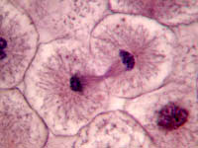
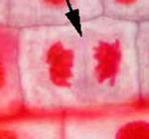
Cytokinesis
The cytoplasm distributed equally between the 2 new cells
In animals, a cleavage furrow forms from outside in
In plants, a cell plate forms from inside out
Animal
Plant
Notes:
Thanks to person who introduced me
Explain presentation style
Different, wacky, interactive
Reason for madness- will be reviewed during implications
May be asked to be an active participant
May be asked to reinforce others
Will be reinforced with candy
Comments/questions welcomed throughout
Reinforce me for doing well
Have participants guess the number of new things they will learn today

Slide 17
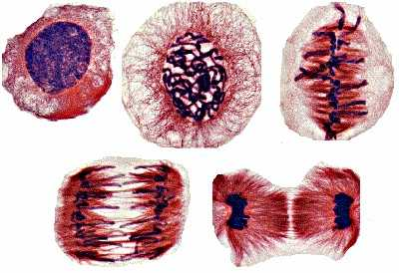
What Mitosis Actually Looks Like
Interphase
Prophase
Metaphase
Telophase
Anaphase
http://www.sci.sdsu.edu/multimedia/mitosis/mitosis_gif2.html
http://science.nhmccd.edu/biol/bio1int.htm
Notes:
Thanks to person who introduced me
Explain presentation style
Different, wacky, interactive
Reason for madness- will be reviewed during implications
May be asked to be an active participant
May be asked to reinforce others
Will be reinforced with candy
Comments/questions welcomed throughout
Reinforce me for doing well
Have participants guess the number of new things they will learn today

Slide 18
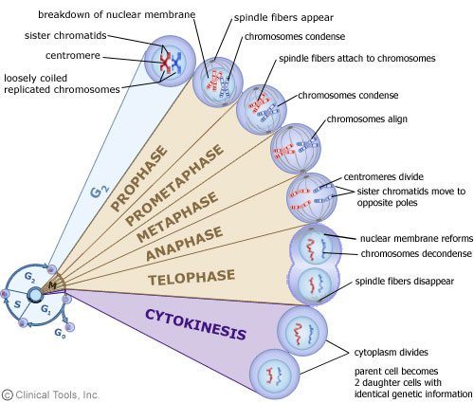
Summary of Mitosis
Notes:
Thanks to person who introduced me
Explain presentation style
Different, wacky, interactive
Reason for madness- will be reviewed during implications
May be asked to be an active participant
May be asked to reinforce others
Will be reinforced with candy
Comments/questions welcomed throughout
Reinforce me for doing well
Have participants guess the number of new things they will learn today

Slide 19
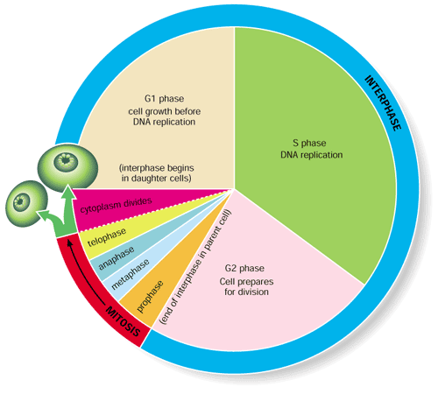
What Happens After Mitosis?
The cell returns to interphase
Chromosomes uncoil back into chromatin
The cycle repeats itself over & over…
Notes:
Thanks to person who introduced me
Explain presentation style
Different, wacky, interactive
Reason for madness- will be reviewed during implications
May be asked to be an active participant
May be asked to reinforce others
Will be reinforced with candy
Comments/questions welcomed throughout
Reinforce me for doing well
Have participants guess the number of new things they will learn today

Slide 20
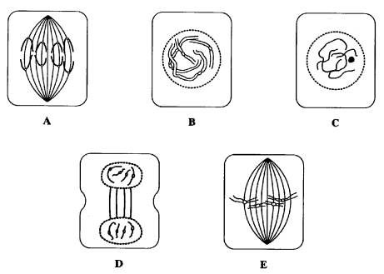
Can You Identify the Stages of Mitosis?
Put the following mitosis stages in the correct sequence
Notes:
Thanks to person who introduced me
Explain presentation style
Different, wacky, interactive
Reason for madness- will be reviewed during implications
May be asked to be an active participant
May be asked to reinforce others
Will be reinforced with candy
Comments/questions welcomed throughout
Reinforce me for doing well
Have participants guess the number of new things they will learn today

Slide 21
The Guarentee
The product of mitosis is 2 cells
The daughter cells are identical to each other & to the mother cell
Mother cell
Identical daughter cells
Why is this so important?
Notes:
Thanks to person who introduced me
Explain presentation style
Different, wacky, interactive
Reason for madness- will be reviewed during implications
May be asked to be an active participant
May be asked to reinforce others
Will be reinforced with candy
Comments/questions welcomed throughout
Reinforce me for doing well
Have participants guess the number of new things they will learn today

Slide 22
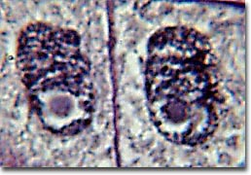
The Daughter Cells
In humans, the 2 daughter cells will have 46 chromosomes (23 pairs)
1 chromosome originally from mom & 1 from dad
Each chromosome is said to have the same gene sequence
Identical daughter cells
Notes:
Thanks to person who introduced me
Explain presentation style
Different, wacky, interactive
Reason for madness- will be reviewed during implications
May be asked to be an active participant
May be asked to reinforce others
Will be reinforced with candy
Comments/questions welcomed throughout
Reinforce me for doing well
Have participants guess the number of new things they will learn today

Slide 23

What kind of cells go through mitosis?
And,,,
Why do we even need to make identical copies of cells?

Slide 24
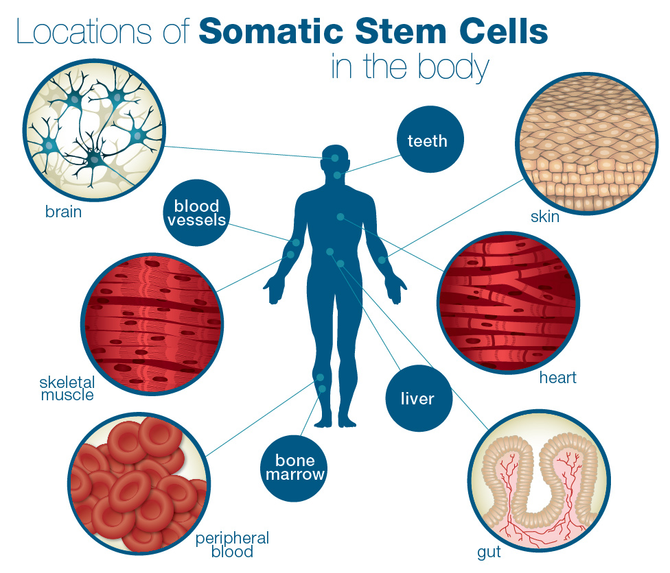
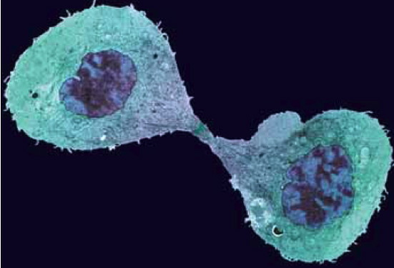
Somatic cells, or body cells duplicate to repair damage or replace dying cells
Certain single celled organisms use mitosis as a form of asexual reproduction

Slide 25
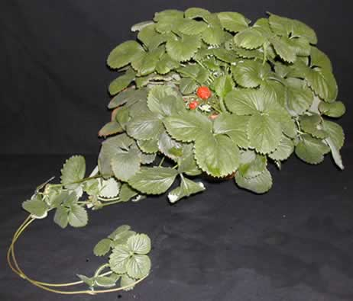

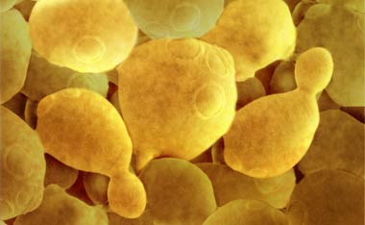
The Beauty of Asexual Reproduction
Mitosis is a form of asexual reproduction
New individuals are produced by 1 parent & thus, are identical to their parent
Mother cell
Runners produces by strawberries
Identical daughter cells
Budding by hydra & yeast
Cuttings from plants
Notes:
Thanks to person who introduced me
Explain presentation style
Different, wacky, interactive
Reason for madness- will be reviewed during implications
May be asked to be an active participant
May be asked to reinforce others
Will be reinforced with candy
Comments/questions welcomed throughout
Reinforce me for doing well
Have participants guess the number of new things they will learn today

Slide 26
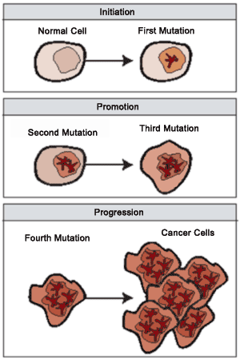
Cell Division Control
DNA controls all cell activities including cell division
Some cells lose their ability to control their rate of cell division – the DNA of these cells has become damaged or changed (mutated)
These super-dividing cells form masses called tumors

Slide 27
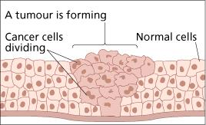
Benign tumors are not cancerous – these cells do not spread to other parts of the body
Malignant tumors are cancerous – these cells break loose and can invade and destroy healthy tissue in other parts of the body (called metastasis)

Slide 28
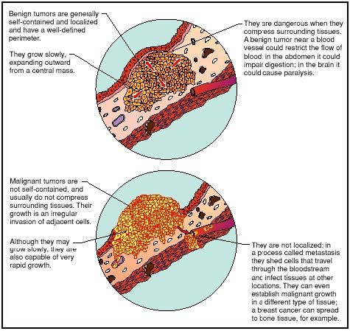

Slide 29
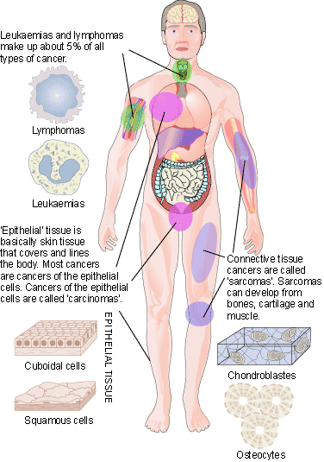
Cancer is not just one disease, but many diseases – over 100 different types of cancers

Slide 30
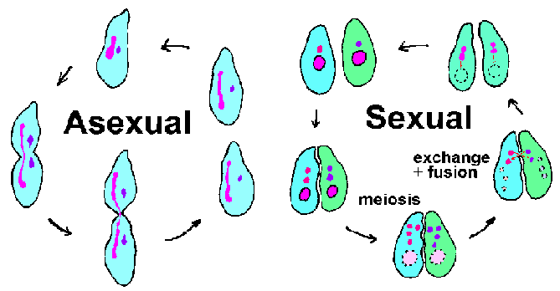
Asexual vs. Sexual Reproduction

Slide 31
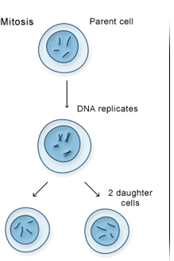
Asexual Reproduction
Requires only one parent
Offspring have 100% the same chromosomes as the parent.
  In other words, the offspring are exact “clones” of the parent.
  Most unicellular organisms
  reproduce this way.
  Mitosis
  Movie

Slide 32
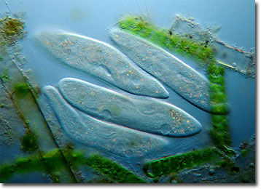
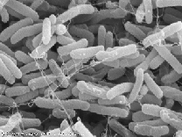
Asexual Reproduction
Binary Fission
  Bacteria
  Protists
Binary fission is a form of asexual reproduction where every organelle is copied and the organism divides in two.

Slide 33
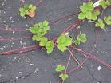

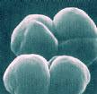
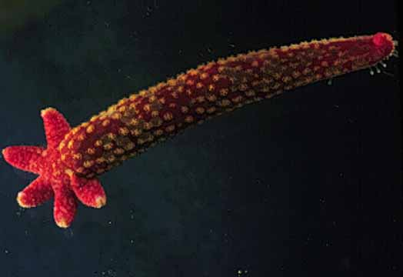
Asexual Reproduction
Examples of organisms that reproduce asexually
  Hydra
  Sea Star
  Strawberry
  Archaebacteria
  Eubacteria
  Euglena
  Paramecium
  Yeast

