Slide 1
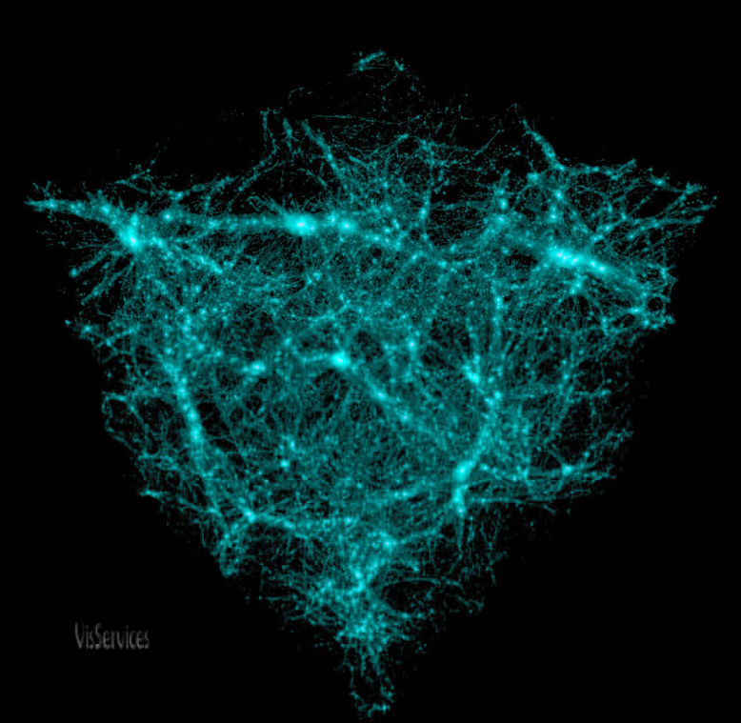
2-1 The Nature of Matter
Objectives:
Identify the 3 subatomic particles found in atoms
Explain how isotopes are different from other atoms
Explain how compounds are different from elements
Describe the two main types of chemical bonds

Slide 2
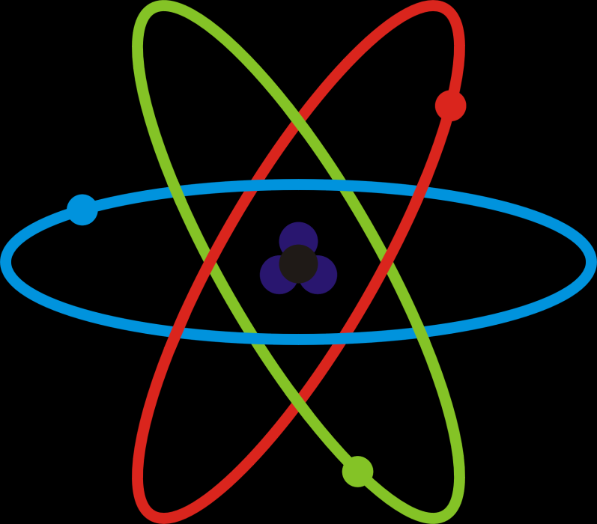
Basic Chemistry
__________ is anything that takes up space and has ______
All matter, living or nonliving, is made up of _________
The smallest unit of an element is an ______

Slide 3
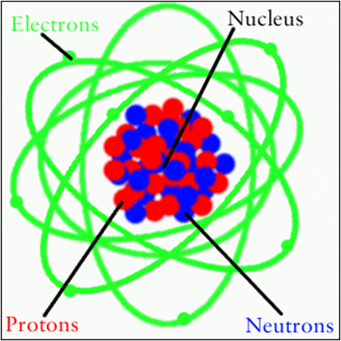
Atomic Structure
Atoms are the smallest unit of an element that still retains that element’s chemical properties
An atom is made up of 3 __________ particles:
_________ (+)
_________ (0)
_________ (-)

Slide 4
Atomic Structure
Protons and neutrons are found in the __________ (center)
Much smaller electrons orbit the nucleus in different energy levels
Electrons are 1/1840 the mass of a proton
An ________ is almost entirely empty space (99.9999999999999%)

Slide 5
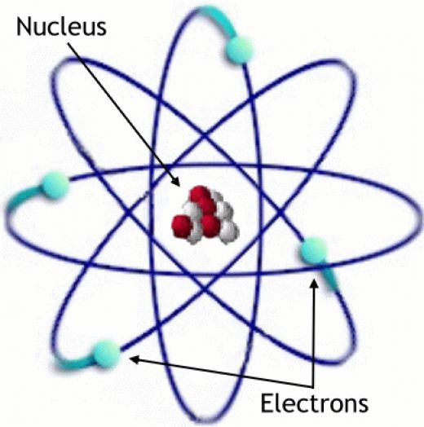
Subatomic Particles
Particle Symbol Charge Relative
Mass
Electron e⁻ - 0
Proton p⁺ + 1
Neutron n 0 1

Slide 6
Electron Shells
Electrons can only occur at certain energy levels or electron shells
Electron shells determine how an atom behaves when it encounters other atoms
The first shell can hold up to 2 electrons, and each shell thereafter can hold up to 8 electrons

Slide 7
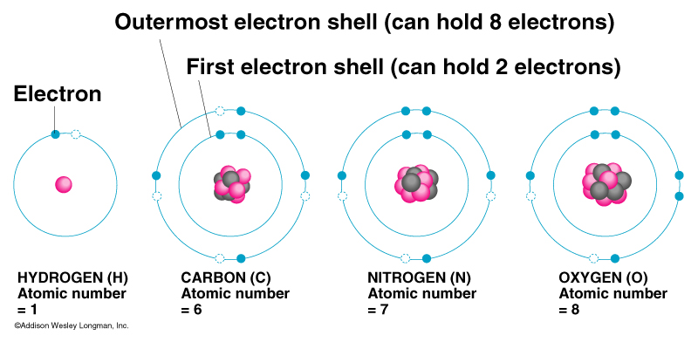
Octet Rule = atoms tend to gain, lose or share electrons so as to have a full outermost shell.
C needs to
N needs to
O needs to
gain 4 electrons
gain 3 electrons
gain 2 electrons

Slide 8
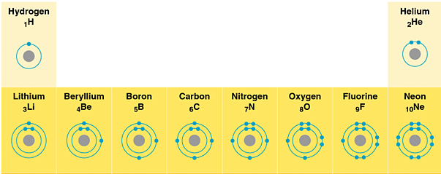
Why are electrons important?
Different electron configurations = different reactivity and types of chemical bonding

Slide 9
Lewis Dot Structures
Symbols of atoms with dots to represent the valence-shell electrons
1 2 13 14 15 16 17 18
H• He:
• • • • • • • • • • •
Li• Be• • B • • C • • N • • O • : F • :Ne :
• • • • • • • •
• • • • • • • • • • •
Na• Mg• • Al• • Si • •P• •S• :Cl • :Ar :
• • • • • • • •

Slide 11
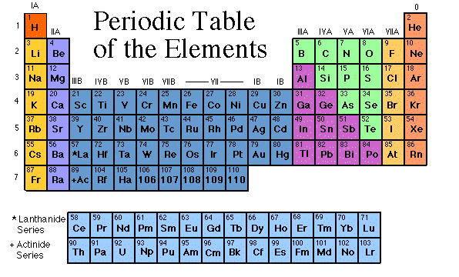
Periodic Table
The periodic table organizes the 118 known elements in a particular way
An element’s position predicts
Physical and chemical properties
How an element will react with others

Slide 12
What’s in a square?
Different periodic tables can include various bits of information, but usually:
atomic number
symbol
atomic mass
number of valence electrons
state of matter at room temperature.

Slide 13
Atomic Number
# of p⁺
No two elements have the same number of protons
Also = # of e⁻
Positive charge = Negative charge
Periodic table arranged by atomic #
Bohr Model of Hydrogen Atom

Slide 14
Atomic Mass
Mass of the nucleus
Mass of e⁻ insignificant
(# of p⁺) + (# of n)
Helium atom with an atomic mass of 4
What is its atomic number?

Slide 15
Isotopes
Forms of an atom with different numbers of neutrons
Some isotopes are radioactive
Their unstable nuclei break down at a constant rate

Slide 16
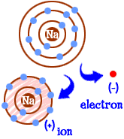
Ions
Ions are charged atoms
Unequal # of p⁺ and e⁻
Have either gained or lost electrons
Gained e⁻ → negative charge
Lost e⁻ → positive charge

Slide 18
In an IONIC bond,
electrons are lost or gained,
resulting in the formation of IONS
K
F

Slide 19
K
F

Slide 20
K
F

Slide 21
K
F

Slide 22
K
F

Slide 23
K
F

Slide 24
K
F

Slide 25
_
K
+
F

Slide 26
_
K
+
F
The compound potassium fluoride
consists of potassium (K⁺) ions
and fluoride (F⁻) ions

Slide 27
_
K
+
F
The ionic bond is the attraction
between the positive K⁺ ion
and the negative F⁻ ion

Slide 28
So
what
are
covalent
bonds?

Slide 29
In covalent bonding,
atoms still want to achieve
a noble gas configuration
(the octet rule).

Slide 30
In covalent bonding,
atoms still want to achieve
a noble gas configuration
(the octet rule).
But rather than losing or gaining
electrons,
atoms now share an electron pair.

Slide 31
In covalent bonding,
atoms still want to achieve
a noble gas configuration
(the octet rule).
But rather than losing or gaining
electrons,
atoms now share an electron pair.
The shared electron pair
is called a bonding pair

Slide 32
Chlorine forms a
covalent bond
with itself
Cl₂

Slide 33
How
will
two
chlorine
atoms
react?
Cl
Cl

Slide 34
Cl
Cl
Each chlorine atom wants to
gain one electron to achieve an octet

Slide 35
Cl
Cl
Neither atom will give up an electron –
chlorine is highly electronegative.
What’s the solution – what can they
do to achieve an octet?

Slide 36
Cl
Cl

Slide 37
Cl
Cl

Slide 38
Cl
Cl

Slide 39
Cl
Cl

Slide 40
Cl
Cl
octet

Slide 41
Cl
Cl
octet
circle the electrons for
each atom that completes
their octets

Slide 42
Cl
Cl
The octet is achieved by
each atom sharing the
electron pair in the middle
circle the electrons for
each atom that completes
their octets

Slide 43
Cl
Cl
The octet is achieved by
each atom sharing the
electron pair in the middle
circle the electrons for
each atom that completes
their octets

Slide 44
Cl
Cl
This is the bonding pair
circle the electrons for
each atom that completes
their octets

Slide 45
Cl
Cl
It is a single bonding pair
circle the electrons for
each atom that completes
their octets

Slide 46
Cl
Cl
It is called a SINGLE BOND
circle the electrons for
each atom that completes
their octets

Slide 47
Cl
Cl
Single bonds are abbreviated
with a dash
circle the electrons for
each atom that completes
their octets

Slide 48
Cl
Cl
This is the chlorine molecule,
Cl₂
circle the electrons for
each atom that completes
their octets

Slide 49
O2
Oxygen is also one of the diatomic molecules

Slide 50
O
O
How will two oxygen atoms bond?

Slide 51
O
O
Each atom has two unpaired electrons

Slide 52
O
O

Slide 53
O
O

Slide 54
O
O

Slide 55
O
O

Slide 56
O
O

Slide 57
O
O

Slide 58
O
O
Oxygen atoms are highly electronegative.
So both atoms want to gain two electrons.

Slide 59
O
O
Oxygen atoms are highly electronegative.
So both atoms want to gain two electrons.

Slide 60
O
O

Slide 61
O
O

Slide 62
O
O

Slide 63
O
O

Slide 64
O
O
Both electron pairs are shared.

Slide 65
O
O
6 valence electrons
plus 2 shared electrons
= full octet

Slide 66
O
O
6 valence electrons
plus 2 shared electrons
= full octet

Slide 67
O
O
two bonding pairs,
making a double bond

Slide 68
O
O
O
O
=
For convenience, the double bond
can be shown as two dashes.

Slide 69
O
O
=
This is the oxygen molecule,
O2

